Slide 1
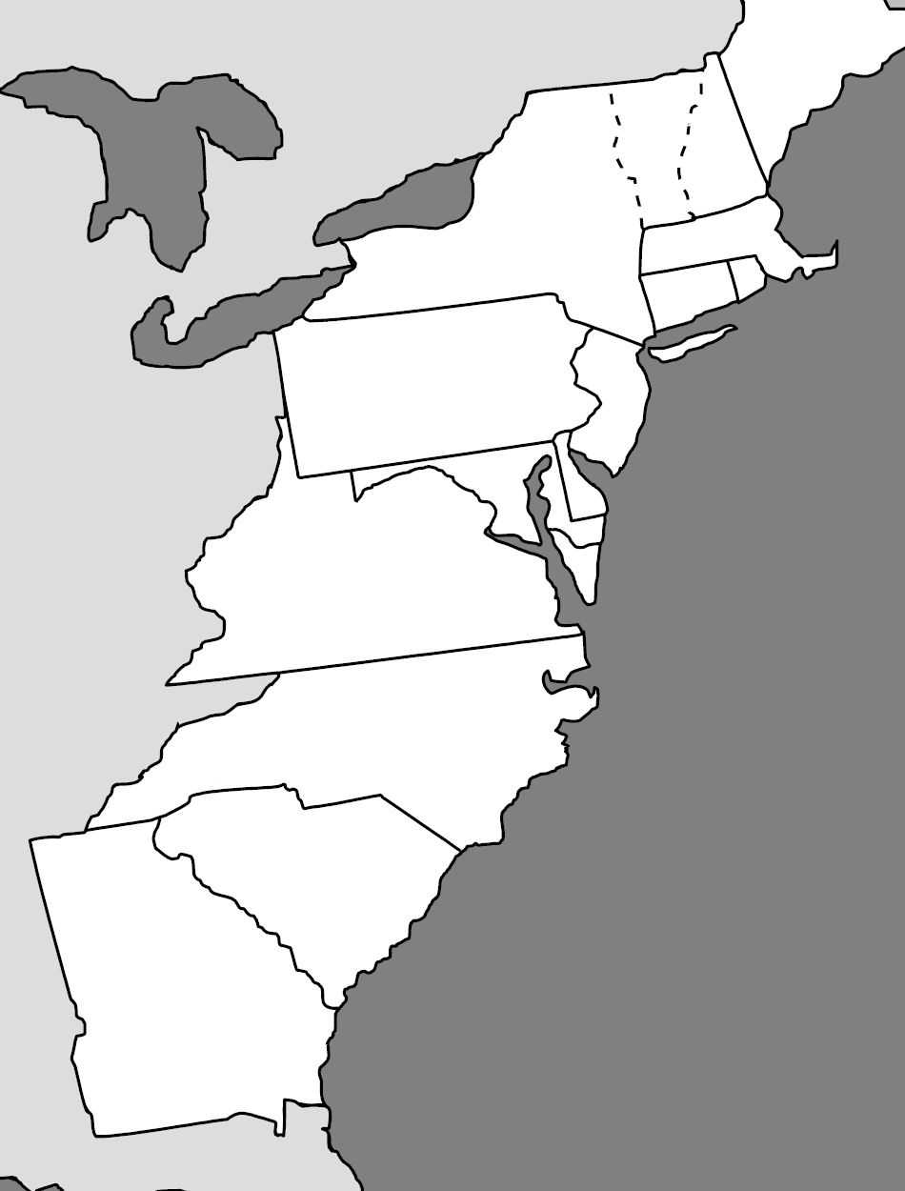
13 Colonies

Slide 2
Virginia
Reason for colony
Economic
Occupations
Farming, Slave trade, Fishing, sailors, blacksmith
Crops
Tobacco, wheat, cotton, food stuff
Virginia - 1606

Slide 3
Massachusetts
Mass
1620
Reasons for colony
Religious
Occupations
Fishing, lumber, whaling, farming, fur trading, cattle raising
Crops
Grain, corn, squash, pumpkin, apples, cranberries
Virginia - 1606

Slide 4
Maryland
Mass
1620
Reasons
Religious (Catholic)
Occupations
Farming, Slave trade, Cattle raising, Fishing
Crops
Tobacco, wheat
Virginia - 1606
Maryland 1632

Slide 5
Connecticut
Mass
1620
Reasons
Escape MA political/religious system
Occupations
Farming, shipping, Fishing, livestock
Crops
Wheat, corn
Conn 1636
Virginia - 1606
Maryland 1632

Slide 6
Rhode Island
Mass
1620
Reasons
separation church and state
Occupations
Rum distiller, iron, fishing, farming, shipping, livestock
Crops
apples, onions, flax
RI 1636
Conn 1636
Virginia - 1606
Maryland 1632

Slide 7
North Carolina
Mass
1620
Reason
Economic
Occupations
Farming, Fur trading, naval supplies, fishing
Crops
tobacco, rice, indigo, food stuff
RI 1636
Conn 1636
Virginia - 1606
Maryland 1632
North Carolina 1663

Slide 8
South Carolina
Mass
1620
Reasons
Economic
Occupation
Farming, Shipping
Crops
Rice, indigo, silk, foodstuff
RI 1636
Conn 1636
Virginia - 1606
Maryland 1632
North Carolina 1663
South Carolina 1663

Slide 9
New York
Mass
1620
New York 1664
Reasons
Economic (Fur Trade), Religious
Occupations
Fur trade, farming, fishing, shipping, lumber, manufacturing
Crops
Wheat, corn, barley
RI 1636
Conn 1636
Virginia - 1606
Maryland 1632
North Carolina 1663
South Carolina 1663

Slide 10
New Jersey
Mass
1620
New York 1664
Reasons
Economic/Religious
Occupations
Trade, Fishing, Farming, lumber, iron
Crops
Wheat, Barley, Corn
New Jersey 1664
RI 1636
Conn 1636
Virginia - 1606
Maryland 1632
North Carolina 1663
South Carolina 1663

Slide 11
New Hampshire
New Hampshire 1680
Mass
1620
New York 1664
Reasons
Religious
Occupations
Farming, Fishing, Shipping, Lumber, Trade, Cattle
Crops
corn, wheat, apples, squash
New Jersey 1664
RI 1636
Conn 1636
Virginia - 1606
Maryland 1632
North Carolina 1663
South Carolina 1663

Slide 12
Pennsylvania
New Hampshire 1680
Mass
1620
New York 1664
Reasons
“Holy Experiment” (Quakers)
Occupations
Farming, Shipping, Lumber, Fur, Paper
Crops
Wheat, corn, rye, flax
New Jersey 1664
RI 1636
Pennsylvania 1681
Conn 1636
Virginia - 1606
Maryland 1632
North Carolina 1663
South Carolina 1663

Slide 13
Delaware
New Hampshire 1680
Mass
1620
New York 1664
Reason
Holy Experiment
Occupations
farming, fishing, shipping,
Crops
Corn, wheat
New Jersey 1664
RI 1636
Pennsylvania 1681
Conn 1636
Virginia - 1606
Delaware 1681
Maryland 1632
North Carolina 1663
South Carolina 1663

Slide 14
Georgia
New Hampshire 1680
Mass
1620
New York 1664
Reasons
Debtor Colony
Occupations
Farming, lumber, shipping
Crops
Rice, tobacco, peanuts, oranges
New Jersey 1664
RI 1636
Pennsylvania 1681
Conn 1636
Virginia - 1606
Delaware 1681
Maryland 1632
North Carolina 1663
South Carolina 1663
Georgia 1732

