Slide 1
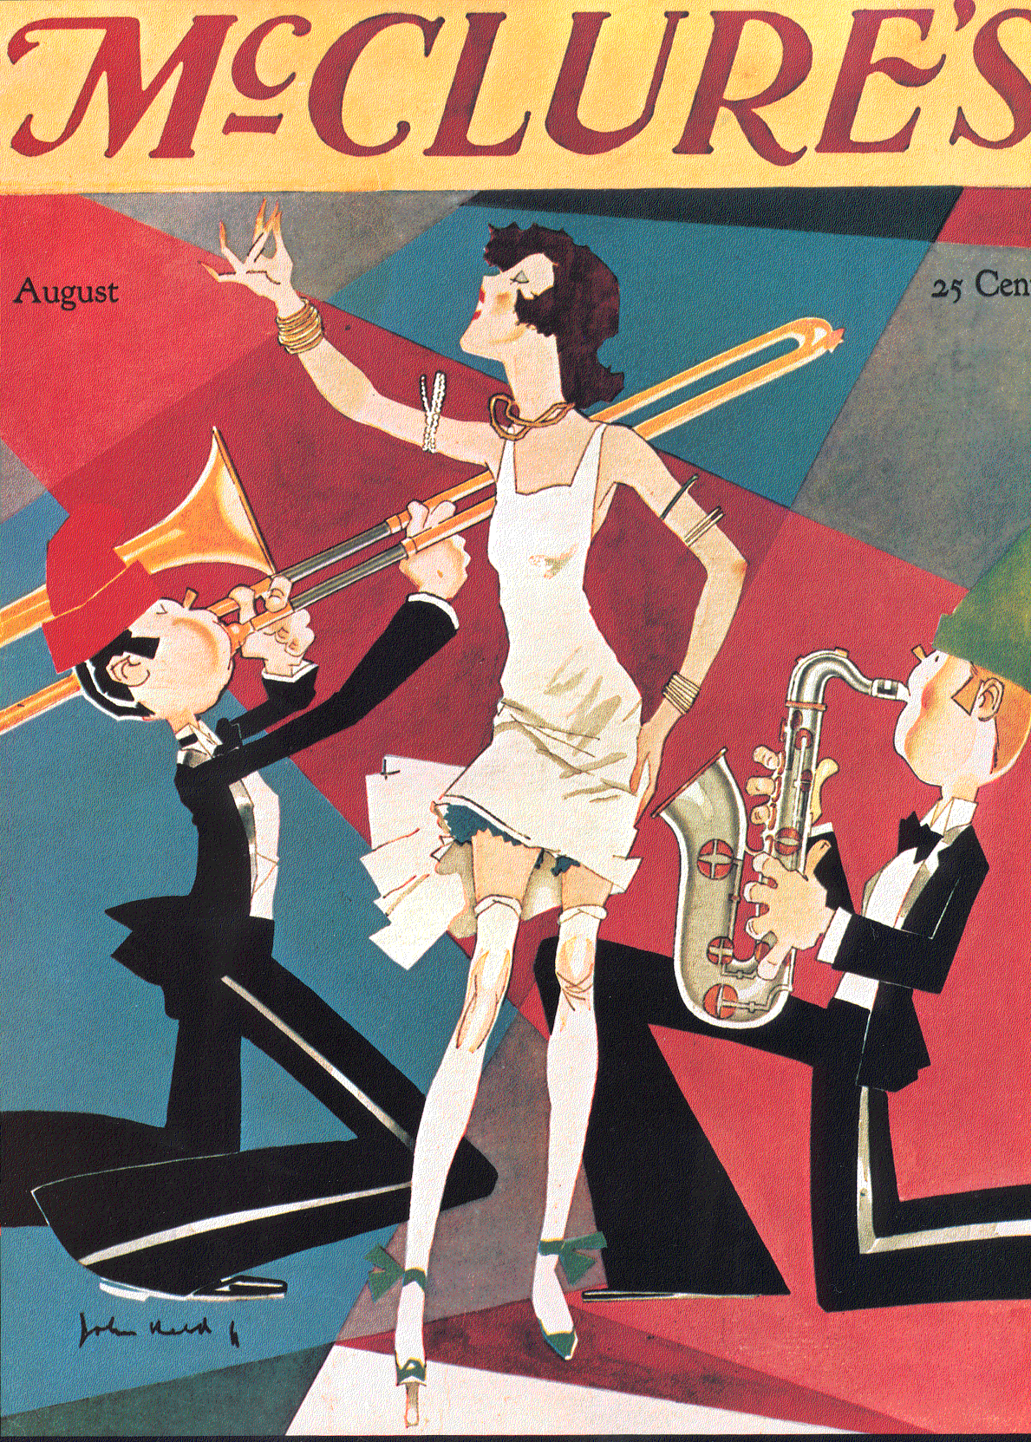
The American Dream:
1920s

Slide 2
How are the 1920s going to be different?
Your Nation just won
“the war to end all wars”
(WWI)
What are you going to do!?

Slide 3
After the war = clash in values!
New Morality
all about personal freedom
v.
Fundamentalist
Old school traditionalists

Slide 4
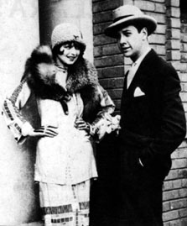
New Morality
FREEDOM.
Young & Modern.
Worked and spent money on music, fashion, and other entertainment
Urban (cities- it’s where the action is)

Slide 5
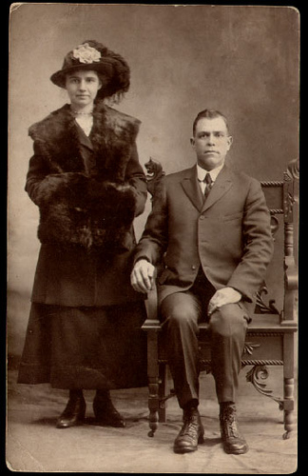
Fundamentalists
Very Religious: they believed that the Bible was 100% correct and that god created man.
Sometimes older generation
Lived in rural areas (farms/Midwest)

Slide 6
The 1920’s new American Dream:
The Gangster Lifestyle
Why was the gangster lifestyle so
popular at the
turn of the century?

Slide 7
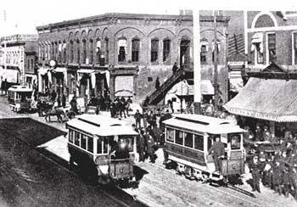
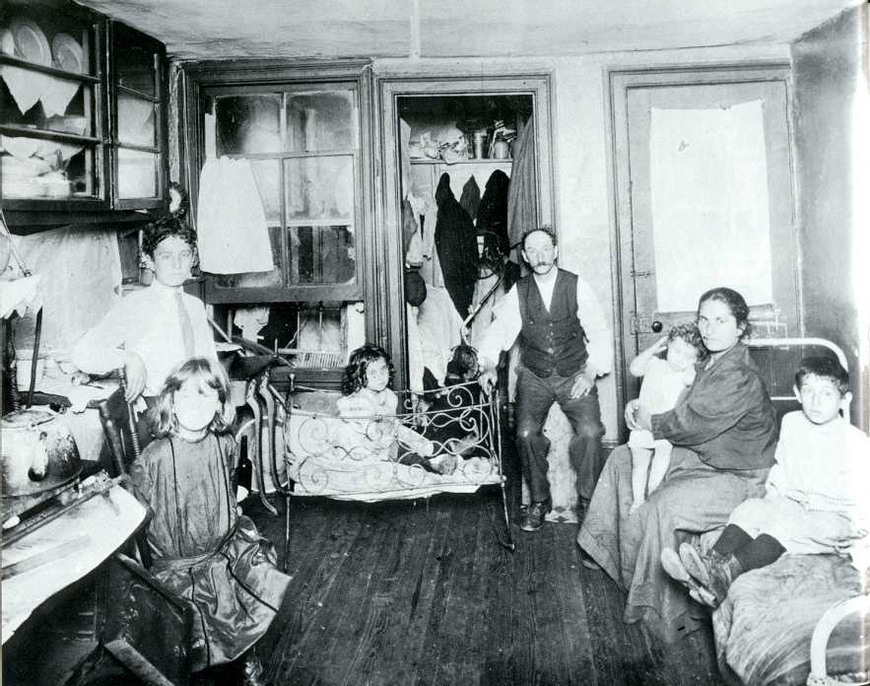
Historical Events → Gangster
#1.) Mass Immigration to USA cities
CAUSE
EFFECT
WWI (1914-1918)
destroyed Europe
millions of
immigrants
moved to America
Influence on Gangster? =
some turned to crime in order to survive

Slide 8
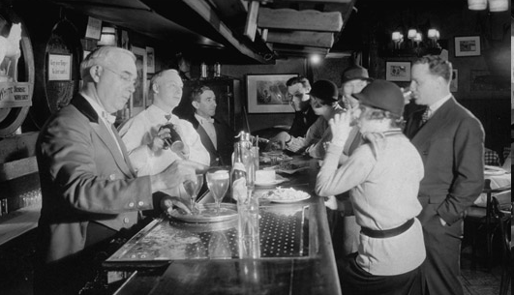
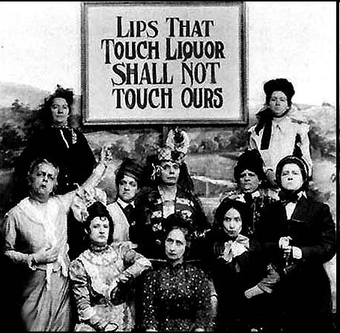
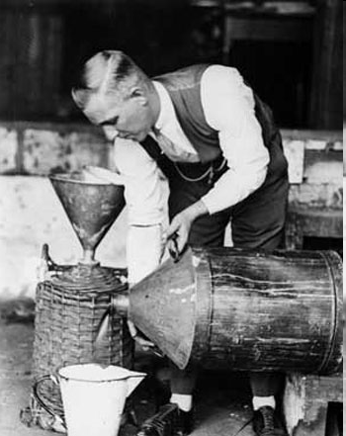
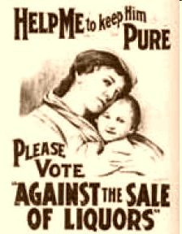
Historical Events → Gangster
Prohibition
#2.) The 18th Amendment (1919)
CAUSE
EFFECT
society was drunk
and misbehaving
Gov. outlawed
Liquor
production,
consumption
& sale
Speakeasy
Bootleg Liquor
Influence on Gangster? =
became organized and made more $$

Slide 9
X
Scarface
1932

Slide 10
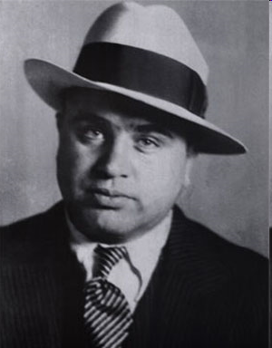
Al Capone (1899-1947)
- Alphonse Capone
Jan. 17, 1899
Got his scars during bar fight
expelled from HS at 15
Took control of
Chicago when the Old Boss
was assassinated
- Oct 1931 went to jail for tax
evasion
- Died Jan 25, 1947
“Public Enemy #1”

Slide 11
Today’s Topic: Motion Picture Production Code
Was the pop culture of 1920s America corrupting the citizens?
Should films & radio be censored?

Slide 12
New Morality
Fundamentalists

Slide 13
Example: 1920s Censorship:
Prohibition Jan. 1920 = 18th Amendment
People Fear = life is changing, becoming corrupt…all b/c of alcohol!

Slide 14
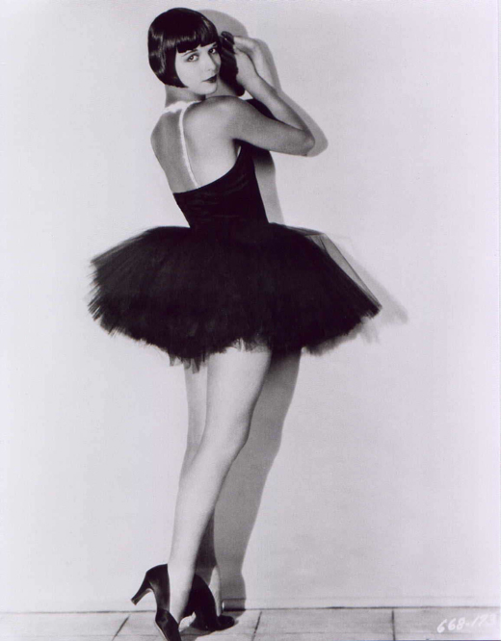
Example: 1920s Censorship:
Target = Loose behavior in Film
People Fear = movies are sending a bad message
By 1930s =
strict Motion Picture
Production Code = Hays Code

Slide 15

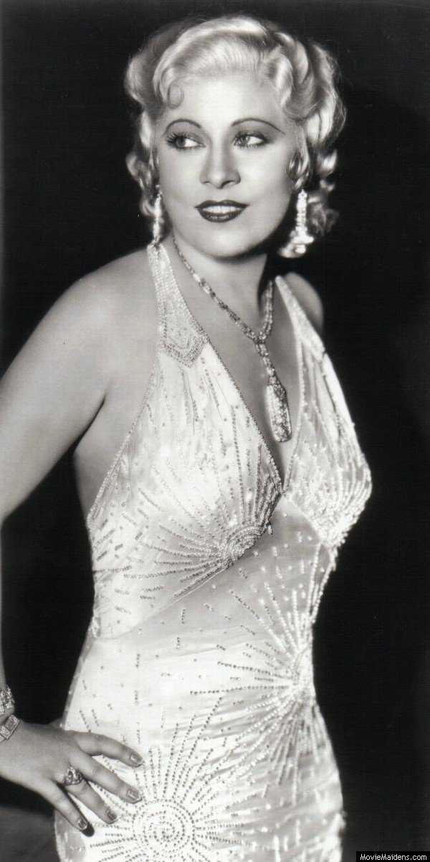
Mae West
Spent her career pushing the boundaries of sexual and moral behavior
Outraged critics with two sensational Broadway productions in 1926 and 1927
  Sex (a play she wrote about a Montreal prostitute)
  The Drag (a “homosexual comedy-drama”)
Arrested in 1928 for her play about a troupe of female impersonators, Pleasure Man
Moved from Broadway to Hollywood in 1932, surprising considering that the film industry followed the MPPC (tighter moral scrutiny)

Slide 16
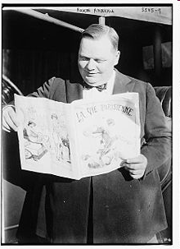
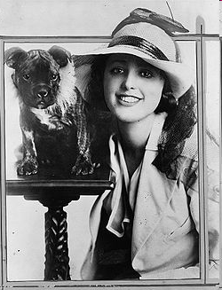
Roscoe Conkling "Fatty" Arbuckle
(March 24, 1887 – June 29, 1933)
Highest paid Silent Film Actor ($1 mill in 1918)
Mentored Charlie Chaplin
Labor 1921: Miss Virginia Rappe got sick at his party and soon died.
Arbuckle stood trial 3 times for manslaughter.
Acquitted.

Slide 17
Scandalist film…
Notes:
The Gay Shoe Clerk on youtube

Slide 18
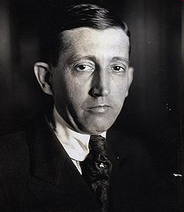
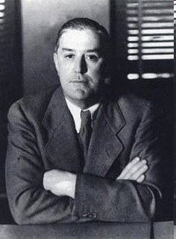
1920s Censorship
Will Hays
Wrote the Code
Joe Breen
Enforced the Code

Slide 19
The Hays Code
Cannot say:
*&^$^@
Or
$%#@^*
Or
$#@*()&^
Or
#%%#&@@
OR
#@&*^%#
The rules:
“No picture shall be produced that will lower the moral standards of those who see it”
Only correct standards of life shall be presented
No ridicule of the law or law enforcement agencies (criminals cannot be shown in a sympathetic light)
NO: nudity, “suggestive” dancing, ridicule of religion, no drug use, methods of crime, homosexuality, interracial marriage, STDs, or depiction of child birth, scenes of passion, excessive and lustful kissing

Slide 20
