Slide 1
1950s:
The Postwar Boom
(Or, Be the Best American you can be)

Slide 2
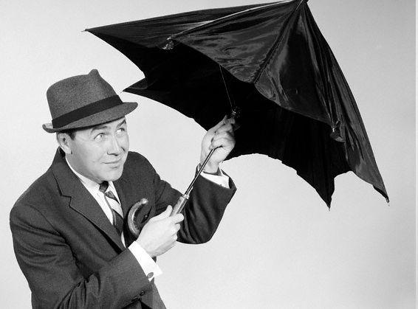
Despite Cold War fears, in the 1950s most Americans found themselves living in a nice home, with a better job, and money to spend…

Slide 3

  GI Bill 1944
    College tuition
    1 year unemployment benefits
    Low interest loans; veterans could buy
    homes!

Slide 4
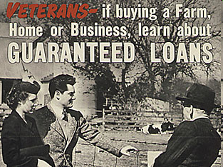

Slide 5
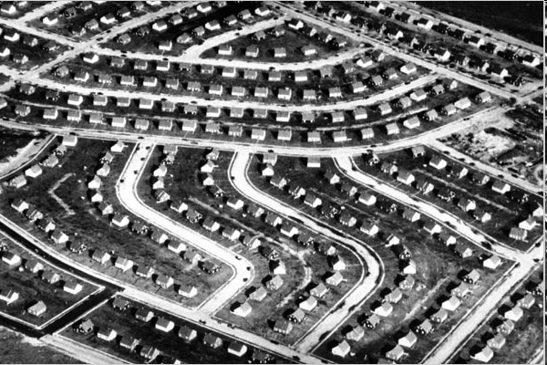
1st SUBURB = Levittown, New York

Slide 6
Life in the Suburbs
Mass production of simple and similar looking homes
Move to the suburbs to avoid crime and congestion of city
Viewed as a move up to a better life
Affordable
Suburbs = American dream in 1950s
  Own your own home
  Send your kids to good schools
  Live in a safe neighborhood
  Enjoy economic security

Slide 7
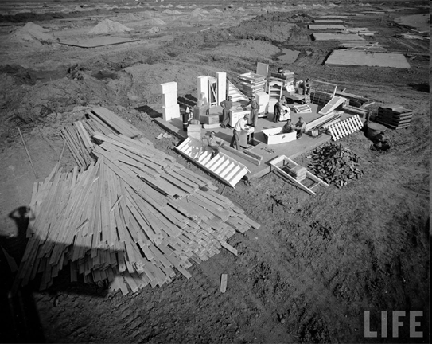
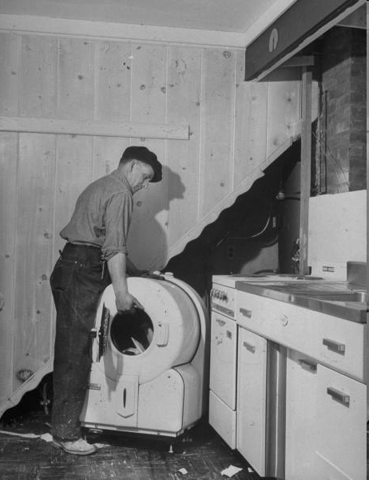

Slide 8
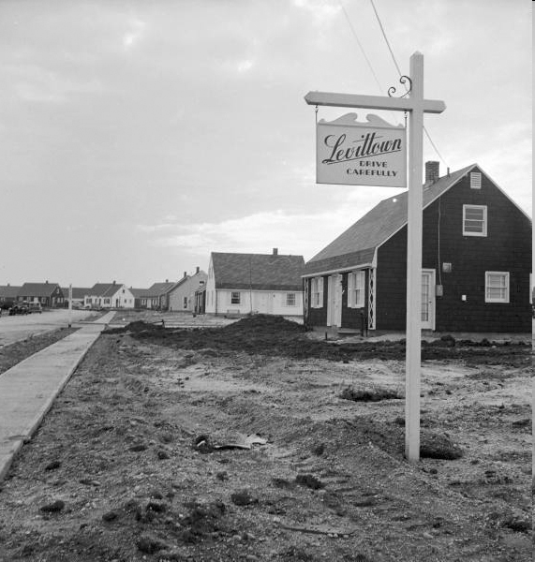

Slide 9
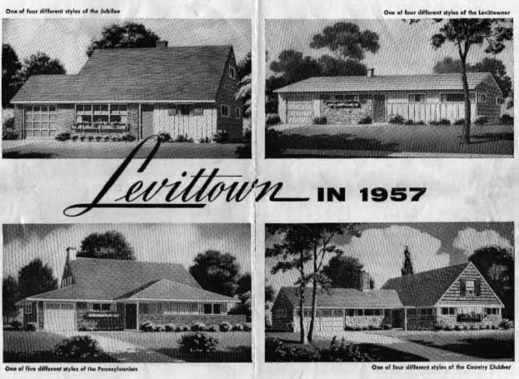

Slide 10
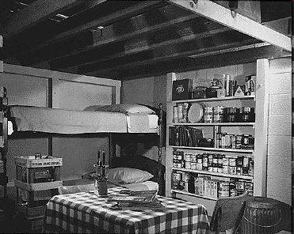

Slide 11
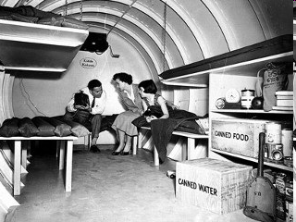

Slide 12
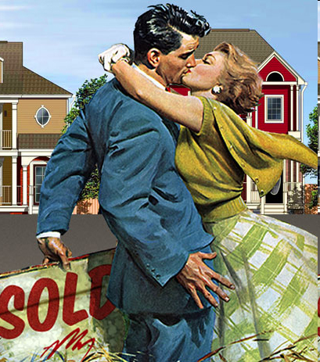
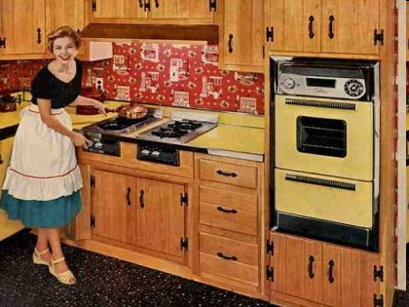
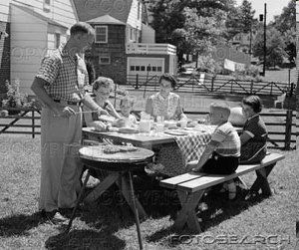
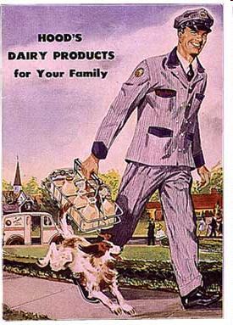

Slide 13
Women in the 1950s
Traditional role of homemaker
Postwar emphasis was on having babies and creating a family
-Gov’t studies say eventually the Soviets will outnumber Americans
= BABY BOOM!!
“A good mother should stay home
to take care of her children”
“Set your sights on a happy home, a host of friends and a bright future through success in HIS job.”

Slide 14
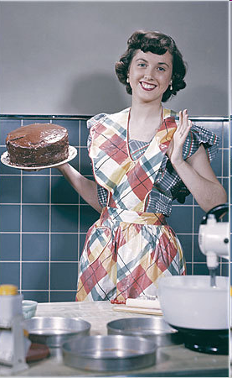
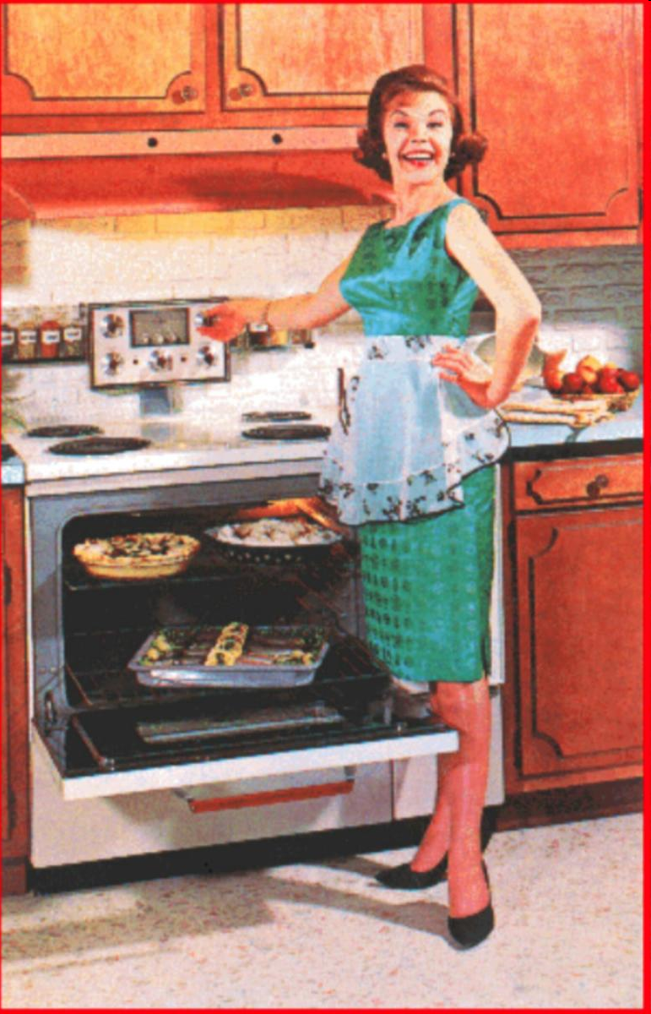

Slide 15
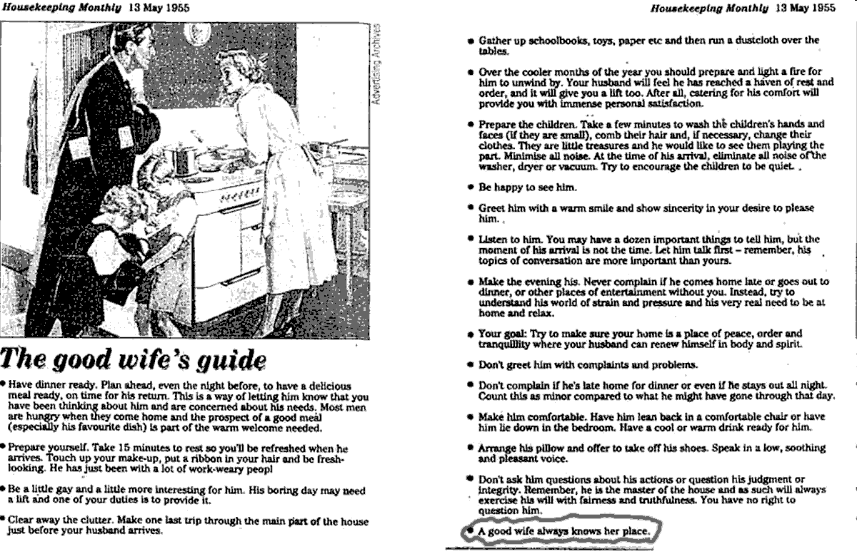

Slide 16

The American Dream in the 1950s
1950s Economy
Why was there no recession after World War II?
1.) “Big” Business & Mass Production
2.) New Industries
3.) Increased leisure time & Consumerism
No More Rationing!
4.) Increase in Population (Baby Boom)

Slide 17
1.) “Big” Business & Mass Production
Type of Work changes:
Less Blue Collar Jobs
More White Collar Jobs
Blue: manufacturing goods for sale
White: management, sales, usually better paid.
Franchises: a company that offers similar products/services in many locations. Ex: McDonalds

Slide 18
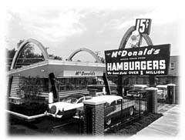
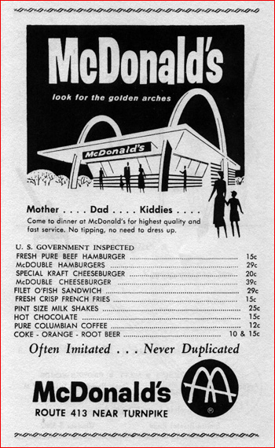
1950s McDonald's

Slide 19
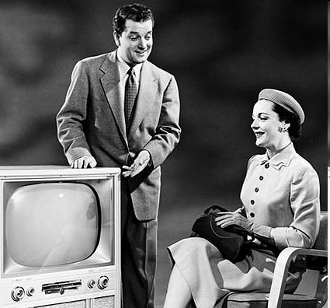
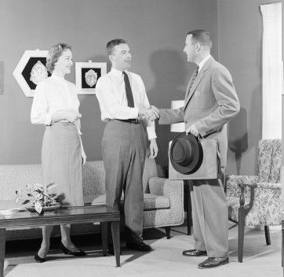
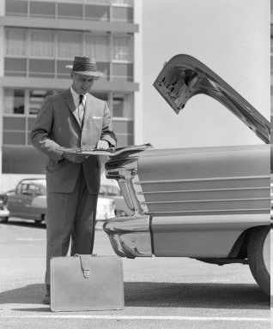
White Collar Jobs

Slide 20
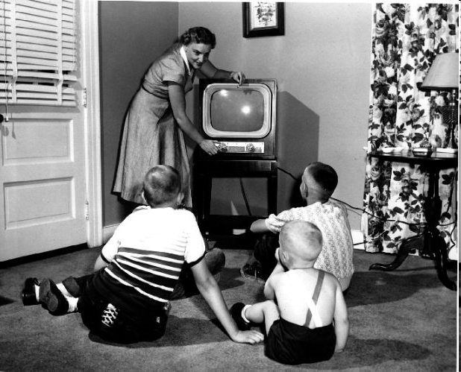

2.) New Industries
Technology
Advertizing

Slide 21
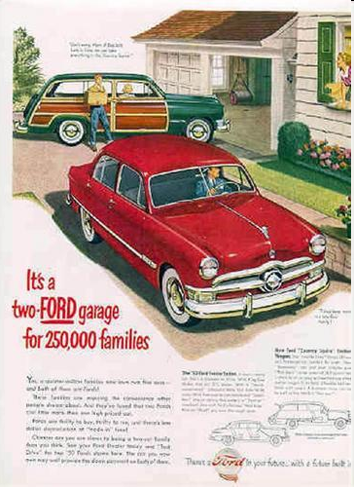

Slide 22
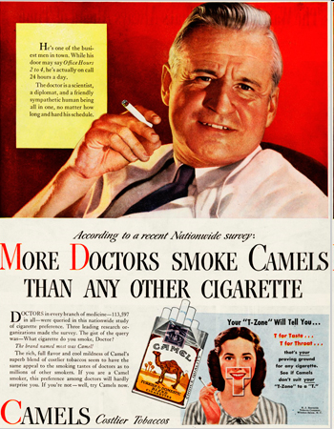
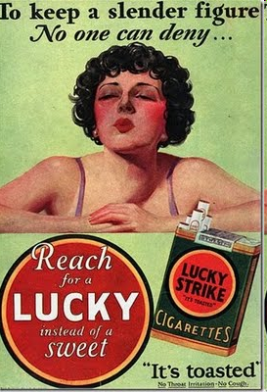

Slide 23
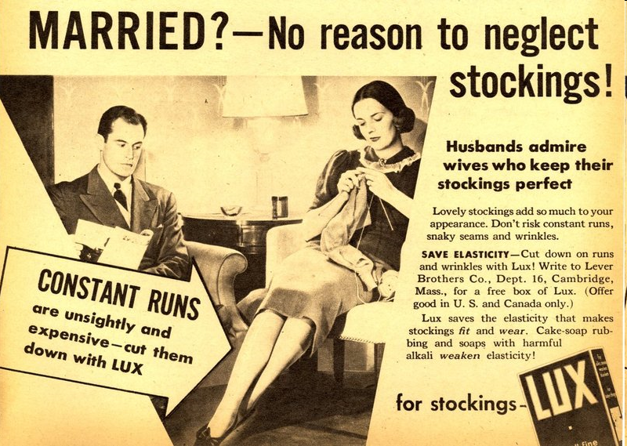

Slide 24
Increased Leisure Time
1.) White Collar Jobs = 40 hour work week, weekends, and 2 weeks vacation time
2.) People had time saving technology
ex: washing machine
Positive?
More Free Time = More time to Spend!
Negative?
Too much Free Time = bad choices!

Slide 25
What else can you do with
more money
and
more free time?

Slide 26
The Baby Boom
Part of the 1950s American Dream = Ideal Family
Vets returning home to families = babies
Economic good times = babies
Advances in Medicine = babies!!
72 million babies were born (1945-1963)
**Dr. Jonas Salk = polio vaccine**

Slide 27
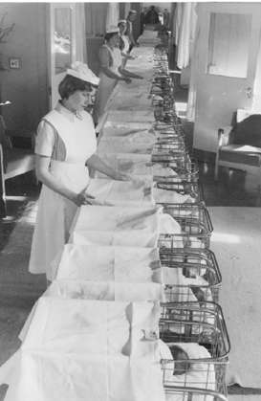
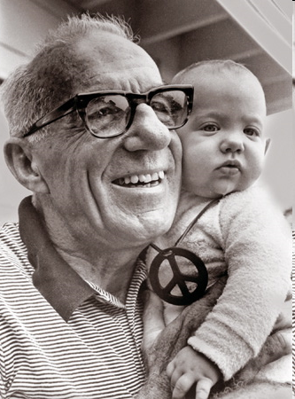
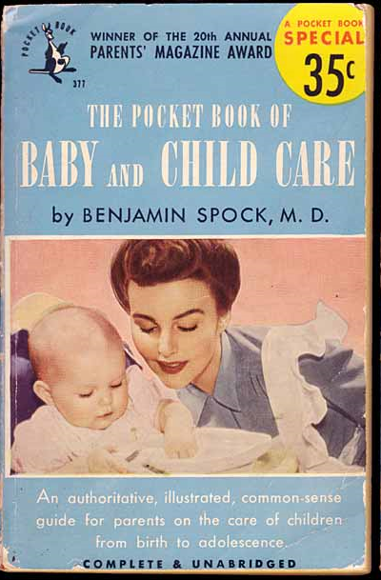
Dr. Spock
New Ideas about raising children:
“Spare the Rod…spoil the child”

Slide 28
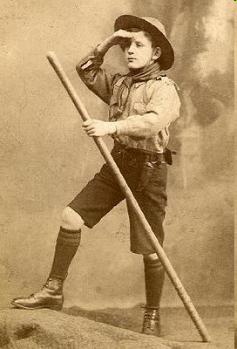
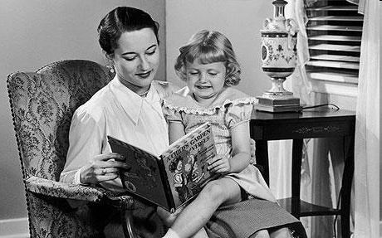
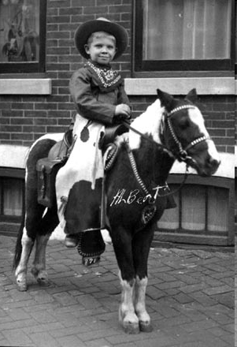
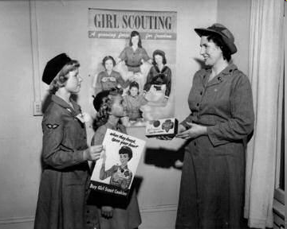

Slide 29
By 1950s most baby boomers were teens
1950s will not have to work b/c parents are making good money.
Oh no…teens + free time =
BAD

