Slide 1
2000s Pop Culture: Fashion, Movies, TV Shows, & Music

Slide 2
2000s Fashion & Fads

Slide 3
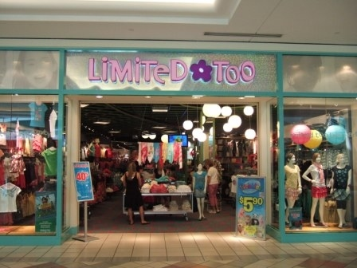
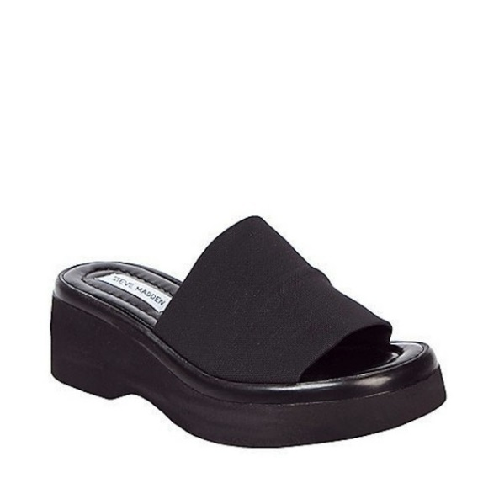
You wore these when you wanted to look hot. But also casual, you know?
This was a really cool store….
These necklaces were really popular
You wore this when you wanted to be comfortable but look cute

Slide 4
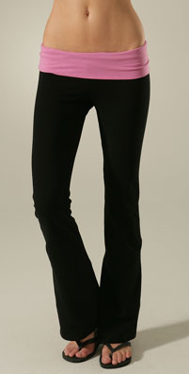
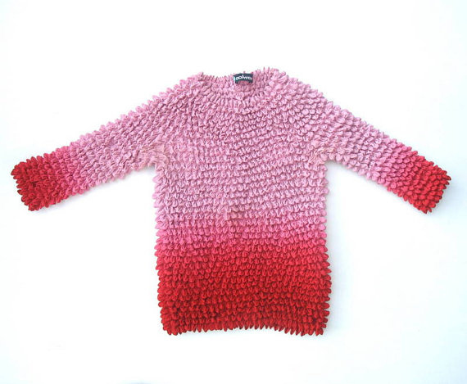
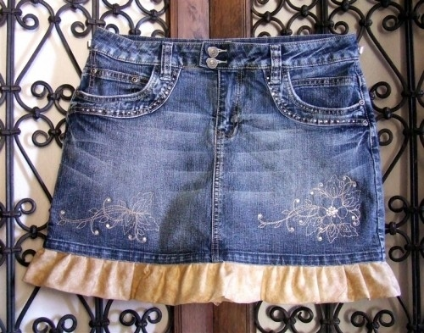
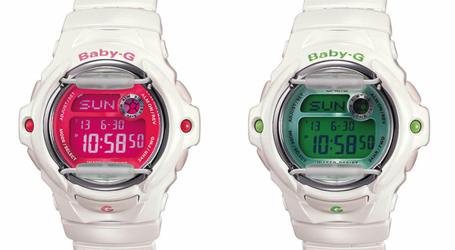
All of these were in style…

Slide 5
2000s Movies

Slide 6
X-Men (2000)
Two mutants come to a private academy for their kind whose resident superhero team must oppose a terrorist organization with similar powers.

Slide 7
Gladiator (2000)
When a Roman general is betrayed and his family murdered by an emperor's corrupt son, he comes to Rome as a gladiator to seek revenge.

Slide 8
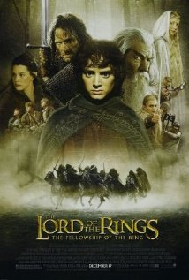
LOTR Trilogy (2001-2003)
A meek hobbit of the Shire and eight companions set out on a journey to Mount Doom to destroy the One Ring and the dark lord Sauron.

Slide 9
Harry Potter and the Sorcerer’s Stone (2001)
Rescued from the outrageous neglect of his aunt and uncle, a young boy with a great destiny proves his worth while attending Hogwarts School of Witchcraft and Wizardry.

Slide 10
Spider-Man (2002)
When bitten by a genetically modified spider, a nerdy, shy, and awkward high school student gains spider-like abilities that he eventually must use to fight evil as a superhero after tragedy befalls his family.

Slide 11
Pirates of the Caribbean – Curse of the Black Pearl (2003)
Blacksmith Will Turner teams up with eccentric pirate "Captain" Jack Sparrow to save his love, the governor's daughter, from Jack's former pirate allies, who are now undead.

Slide 12
Mean Girls (2004)
Cady Heron is a hit with The Plastics, the A-list girl clique at her new school, until she makes the mistake of falling for Aaron Samuels, the ex-boyfriend of alpha Plastic Regina George.

Slide 13
Batman Begins (2005)
After training with his mentor, Batman begins his war on crime to free the crime-ridden Gotham City from corruption that the Scarecrow and the League of Shadows have cast upon it.

Slide 14
300 (2006)
King Leonidas and a force of 300 men fight the Persians at Thermopylae in 480 B.C.

Slide 15
The Dark Knight (2008)
When Batman, Gordon and Harvey Dent launch an assault on the mob, they let the clown out of the box, the Joker, bent on turning Gotham on itself and bringing any heroes down to his level.

Slide 16
Twilight (2008)
A teenage girl risks everything when she falls in love with a vampire.

Slide 17
Avatar (2009)
A paraplegic Marine dispatched to the moon Pandora on a unique mission becomes torn between following his orders and protecting the world he feels is his home.

Slide 18
2000s Music

Slide 19
“50 Songs from the 2000s That Will Instantly Put You in a Good Mood”
1. Jesse McCartney – Leavin’ 19. Christina Aguilera – What a Girl Wants 37. Jimmy Eat World – The Middle
2. Jet – Are You Gonna Be My Girl 20. Justin Timberlake – Senorita 38.DJ Sammy – Heaven
3. Miley Cyrus – Party in the U.S.A. 21. Nine Days – Absolutely (Story of a Girl) 39.Rihanna Umbrella
4. Shakira – Hips Don’t Lie 22. N’Sync – Bye Bye Bye 40.Gnarls Barkley – Crazy
5. Macy Gray – I Try 23. All American rejects – Gives You Hell 41. Britney Spears – Toxic
6. Pink – U and Ur Hand 24. Shaggy – It Wasn’t Me 42. Sisqo – Thong Song
7. Britney Spears – Oops!...I Did It Again 25. Outcast – Hey Ya 43. DMX – Party Up (UP in Here)
8. Bowling for Soup – 1985 26. Natasha Bedingfield – Unwritten 44. Duffy - Mercy
9. The Darkness – I Believe in a Thing Called Love 27. Eiffel 65 – Blue (Da Ba Dee) 45. Kanye West – Gold Digger
10. Ok Go – Here It Goes Again 28. Snoop Dogg – Drop It Like It’s Hot 46. Sara Bareilles – Love Song
11. Pussycat Dolls – Don’t Cha 29. M.I.A. – Paper Planes 47. Janet Jackson – All For You
12. T.I. – Live Your Life 30. Gwen Stefani – Hollaback Gril 48. Will Smith - Switch
13. Christina Aguilera – Come On Over Baby 31. Blink 182 – All the Small Things 49. Missy Elliot – Get Ur Freak On
14. Modest Mouse – Float On 32. Destiny’s Child – Jumpin’ Jumpin’ 50. Weezer – Beverly Hills
15. Beyonce – Crazy in Love 33. Blue Control - Hit ‘em Up Style (oops!)
16. Yellowcard – Ocean Avenue 34. Kelly Clarkson – Since U Been Gone
17. Fountains of Wayne – Stacy’s Mom 35. Gavin De Graw – I Don’t Wanna Be
18. Black Eyed Peas – I Gotta Feeling 36. Fall Out Boy – Sugar, We’re Going Down

Slide 20
2000s TV Shows

Slide 21
Lost (2004-2010)
The survivors of a plane crash are forced to work together in order to survive on a seemingly deserted tropical island.

Slide 22
Mad Men (2007-)
A drama about one of New York's most prestigious ad agencies at the beginning of the 1960s, focusing on one of the firm's most mysterious but extremely talented ad executives, Donald Draper.

Slide 23
NCIS (2003-)
The cases of the Naval Criminal Investigative Service with Special Agent Leroy Jethro Gibbs and his team, Special Agent Anthony DiNozzo, Jr., Special Agent Timothy McGee, Special Agent Kate Todd (Seasons 1 & 2), Moussad Liaison officer Ziva David (Season 3-10), Medical Examiner Dr. Donald (Ducky) Mallard, forensic scientist officiado Abby Sciuto, and Director of NCIS Leon Vance.

Slide 24
Breaking Bad (2008-2013)
To provide for his family's future after he is diagnosed with lung cancer, a chemistry genius turned high school teacher teams up with an ex-student to cook and sell the world's purest crystal meth.

Slide 25
Gilmore Girls (2000-2007
A drama centering around the relationship between a thirtysomething single mother and her teen daughter living in Stars Hollow, Connecticut.

Slide 26
The Colbert Report (2005-)
Satirist news caster Stephen Colbert provides humorous commentary on the big issues going on in the United States and the rest of the world, with his larger then life ego and overly patriotic spirit along with him every step of the way.

Slide 27
MTV’s Cribs (2000-)
MTV's Cribs take you on exclusive tours through the domestic sanctuaries that some of today's most favorite stars call home.

Slide 28
Laguna Beach: The Real Orange County (2004-2006)
MTV follows eight teens living in Laguna Beach nearing the end of high school and beginning the next chapter of their lives.

Slide 29
The Hills (2006-2010)
After high school graduation, "Laguna Beach" alumna Lauren sets out to live on her own in Los Angeles and work as an intern at Teen Vogue.

Slide 30
Lizzie McGuire (2001-2004)
The comic misadventures of a 13-year-old with an animated alter ego starring Hilary Duff.

Slide 31
Even Stevens (1999-2003)
The misadventures of the Stevens family, a family of five from Sacramento, California starring Christy Carlson Romano and Shia LaBeouf.

Slide 32
Hannah Montana (2006-2011)
Adventures of a teenage pop star who keeps her identity secret from even her closest friends by using a disguise on stage.

Slide 33
The OC (2003-2007)
A troubled youth becomes embroiled in the lives of a close-knit group of people in the wealthy, upper-class neighborhood of Newport Beach, Orange County, California.

Slide 34
Veronica Mars (2004-2007)
After her best friend is murdered and her father is removed as county sheriff, Veronica Mars dedicates her life to cracking the toughest mysteries in the affluent town of Neptune.

