Slide 1
Do Now: What were the two “Theaters” (Fronts) in world War II?
Objectives: Students will be able to...(1) describe the major battles of World War II (2) identify key information from text on major WWII battles.
Homework: Project #1 DUE FRIDAY

Slide 2
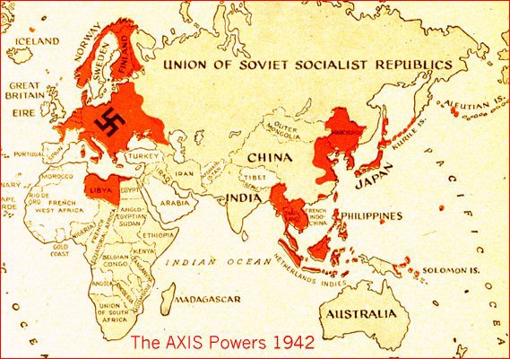

Slide 3
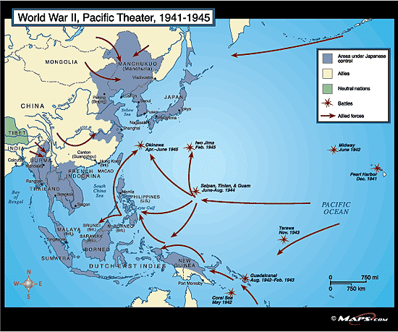
Pacific Theater
Led by Fleet Admiral Chester Nimitz
Island-Hopping: Moving from island to island inching closer to Japan
Predominantly naval and air battles

Slide 4
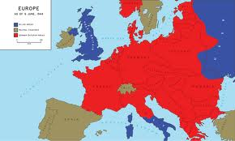
European Theater
Germany moving into Soviet Union
Britain and US not ready to attack right away
Types of fighting:
Ground fighting
Air attacks
Sea battles

Slide 5
Battles Packet
Over the next four days we will be looking at the battles of World War II
Each Day you will work on specific tasks associated with those particular battles (Maps, videos, reading, pictures, etc.)
This will be checked or collected on Friday
You are expected to finish anything you don’t get to that day for homework

Slide 6
Stalingrad Video

Slide 7
Do Now: Take out your Battle Packet – Complete the ‘Do Now’ for day 2
Objectives: Students will be able to...(1) explain the events surrounding D-Day and the events on that day
Homework: Keep working on project

Slide 8
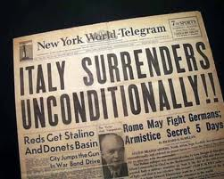
Italy
Americans land in Sicily & creates crisis
King arrests Mussolini:
“ My dear duce, it’s no longer any good. Italy has gone to bits. The soldiers don’t want to fight anymore. At this moment, you are the most hated man in Italy.”

Slide 9
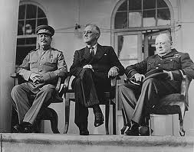
US and Stalin Meeting at Tehran
Stalin agrees to:
attack Germany if US invades in 1944
break up Germany after the War
help US with Japan

Slide 10
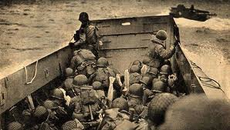

Slide 11
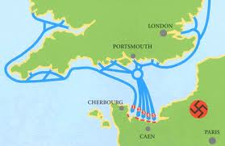

Slide 12
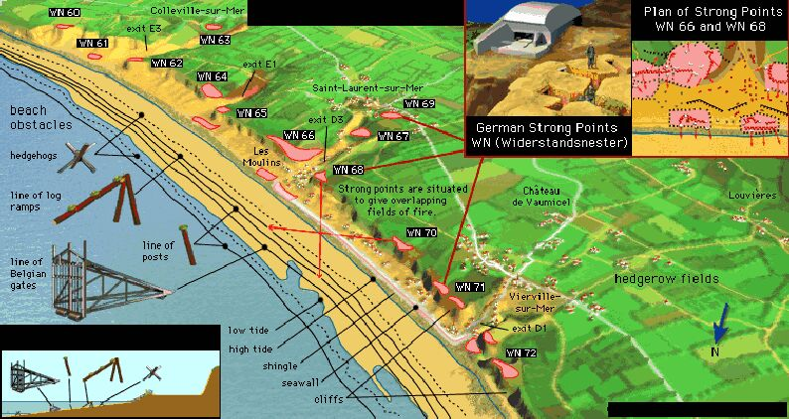

Slide 13
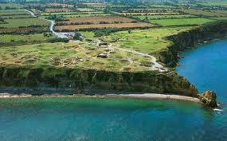

Slide 14
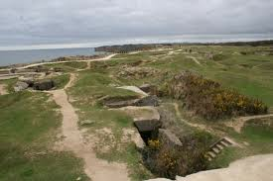

Slide 15
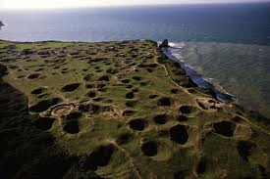

Slide 16
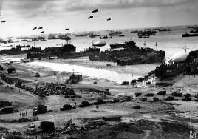
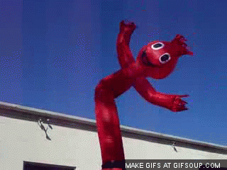
D-Day
Operation Overlord – Code name for invasion of French beaches
Germans knew an invasion would come eventually and fortified
US had element of surprise on location

Slide 17
What had to happen…
Invasion beginning at night
Arrive at low tide
Low tide come in the AM so gunners bombarding coast could see targets
Paratroopers dropped behind enemy lines ahead of time
Moonlit night to see land
Good weather….

Slide 18
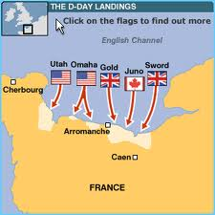
The Longest Day (June 6th, 1944)
7,000 ships, 100,000 soldiers, 23,000 paratroopers
5 Beaches – Code-named “Utah”, “Omaha”, “Gold”, “Sword”, and “Juno”

Slide 19
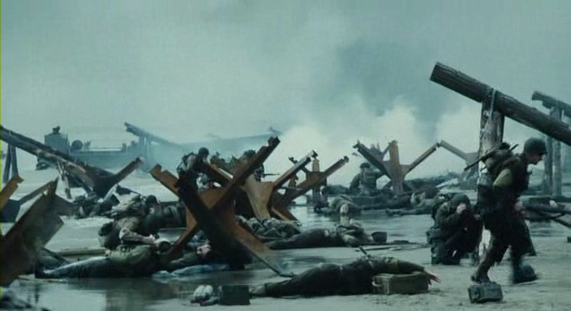
Saving Private Ryan

Slide 20
Do Now: Take out your Battle Packet – Complete the ‘Do Now’ for 3
Objective: Students will be able to..(1) describe battle in the Pacific Theater (2) analyze a video for key information
Homework: Keep working on project #1

Slide 21
Major BAttles
Fall of the Philippines
Battle of Midway
Stalingrad
D-Day
______ “I said, to the people of the Philippines whence I came, I shall return. Tonight, I repeat those words: I shall return!”
______ “Every man who set foot on Omaha Beach that day was a hero”
______ This battle “put an end to the long period of Japanese offensive action” (Turning Point)
______ “The street is no longer measured by meters but by corpses...”

Slide 22
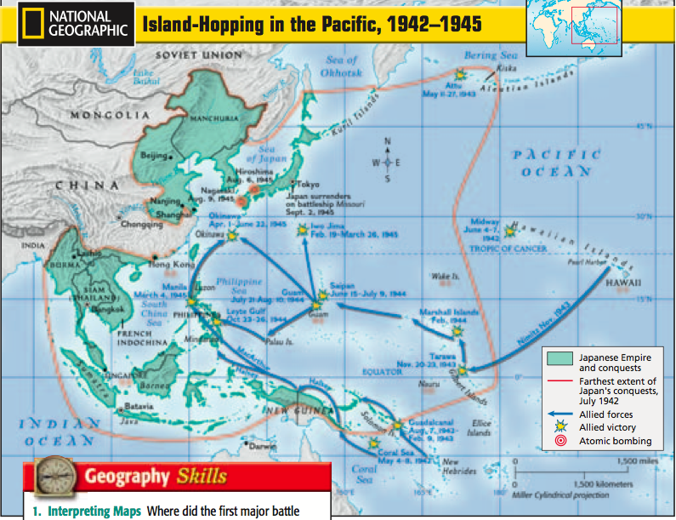

Slide 23
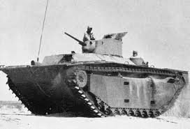
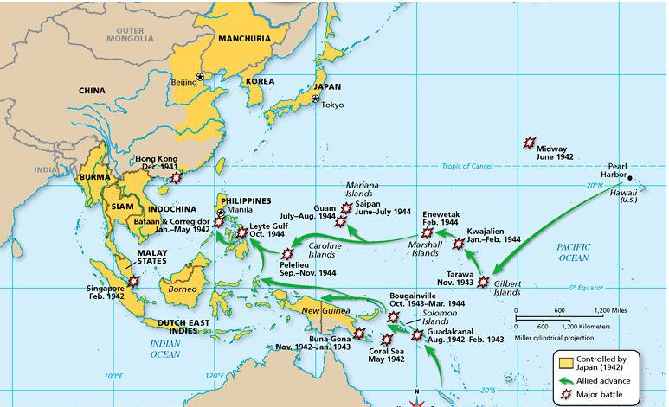
Island Hopping
Two Pronged Attack
Required beach landings (High Casualties)
Amphtrac Helped – “Alligator”, LVT, Amphibious Tractor

Slide 24
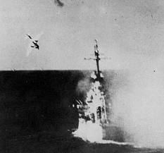
Return to Philippines
US assembled enormous invasion force
MacArthur makes triumphant return
Battle of Leyte Gulf – Largest in Naval History
Kamikaze Attacks – “Divide Wind” – Deliberately crash planes into ships

Slide 25
Battle Packet
Complete section ‘B’ and ‘C’ of day 3

Slide 26
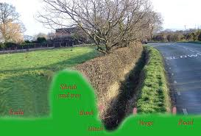
The Collapse of the Third Reich
Germany committing atrocities
FDR – Fastest way to stop them is to defeat Germany
Time to break out of Normandy
Hedgerows – Several feet high dirt walls covered in shrubs
Allies motored through France with help of resisters

Slide 27
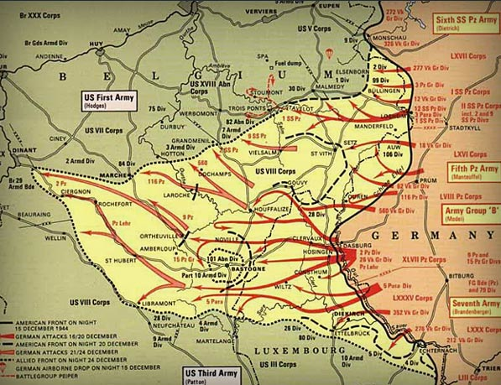
The Battle of the Bulge
Hitler’s last stand – Try to cut off allied supply line
Germany surrounded
General Patton came in to save the day
Germany took major casualties (100,000)
Allies won

Slide 28
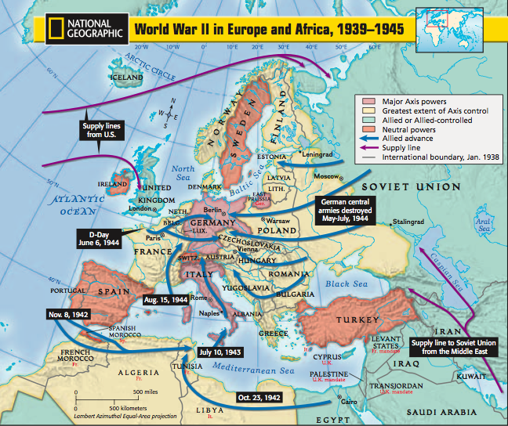
Allies attack from both sides

Slide 29
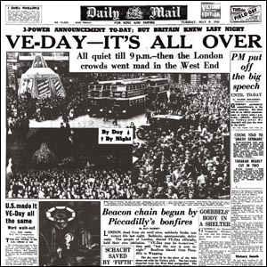
V-E Day
Allies SMASH through German defenses on the East and West
April 30, 1945 – Hitler committed suicide
His secretary took body outside and burned it
March 8, 1945 – Unconditional German surrender (V-E Day: “Victory in Europe”)

Slide 30
Do Now: Take out your Battle Packet and turn to day 4
Objective: Students will be able to..(1) describe battle in the Pacific Theater (2) analyze a video for key information
Homework: Start working on project #2

Slide 31
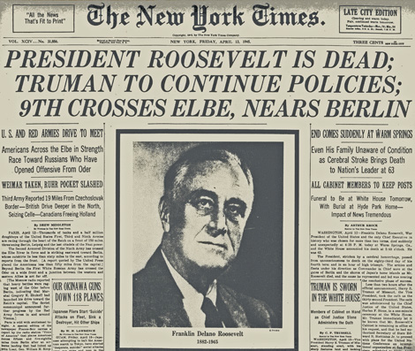
Time to Turn our full force on JApan
FDR Dies and Harry Truman takes over
Germany surrenders a few weeks later
Must now turn full attention on Japan

Slide 32
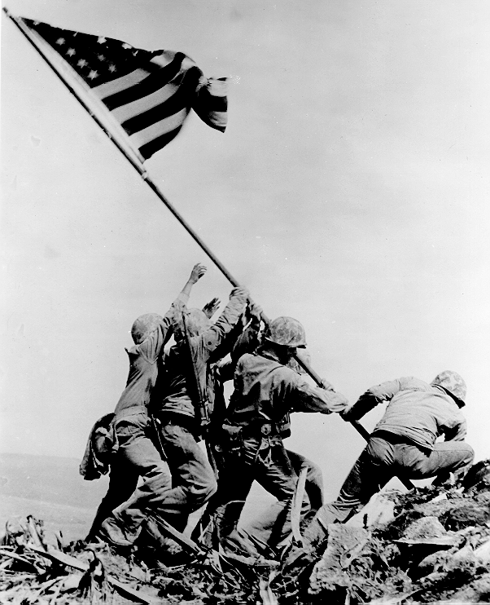
Battle of Iwo Jima
Famous landing on island
Horrible terrain and danger (7,000 US Marines Died)
Nimitz wrote that on Iwo Jima, “uncommon valor was a common virtue”

Slide 33
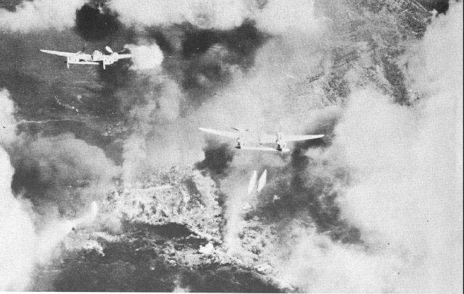
Firebombing Japan
Napalm – Jellied Gasoline
Bombs were designed to start fires
Controversial – Civilians killed
Killed 80,000 people, 250,000 buildings, 67 cities

Slide 34
Victory in the Pacific
We will watch a video that shows footage of two major battles in the Pacific:
Iwo Jima
Okinawa
In addition, this video will give you an insight into US and Japanese tactics of that theater

