Slide 1
“The Pursuit of Perfection”
in Antebellum America
1820 to 1860

Slide 2
The Age of Reform
Reasons:
The Great Awakening sparked interest that the individual could control their destiny and that “good deeds” will make the nation a better place
The middle-class feel that they should be models of behavior for the “unmannered and ill-behaved”
Finally, women are driving forces for reform because they are no longer kept at home and now have a voice (predominantly in the church)
Notes:
*

Slide 3
AGE OF REFORM
1. Ante-Bellum—1820 to 1860
Romantic age
Reformers pointed out the inequality in society
Industrialization vs. progress in human rights
Primarily a Northern movement
Southerners refused reforms to protect slavery
Educated society through
newspaper and public meetings

Slide 4
2. 2nd Great Awakening---1820’s to 1840’s
Rise of Unitarians---believed in a God of love
heaven through good works and helping others
social conscience = social gospel
apply Christ’s teachings to bettering society
3. Formed utopian societies = collective ownership

Slide 5
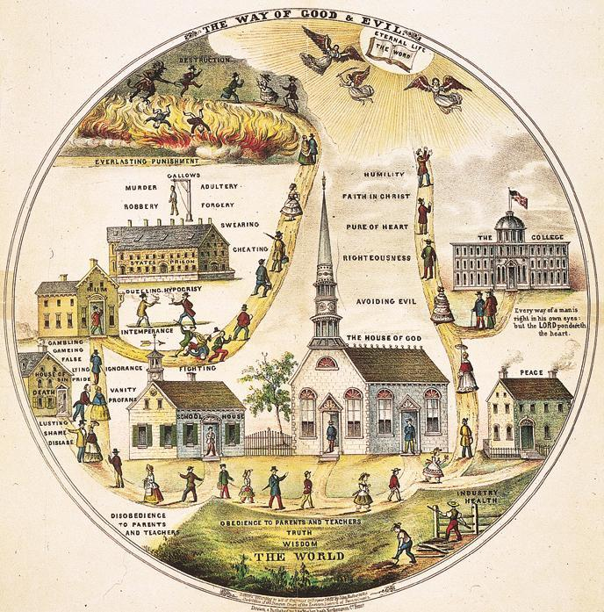
The 2nd Great Awakening

Slide 6
Second Great Awakening = New Religions
Society during the Jacksonian era was undergoing deep and rapid change
The revolution in markets brought both economic expansion and periodic depressions.
To combat this uncertainty reformers sought stability and order in religion
Membership in the major Protestant churches—Congregational, Presbyterian, Baptist, and Methodist—soared
Notes:
*
Evangelical Protestantism was in line with the values of the early 1800s because it stressed the ability of everyone to bring about his or her salvation.
It upheld the American belief in individualism. It also catered to a mass audience without social distinctions. The revivals reinforced the American belief in democracy and equality.

Slide 7
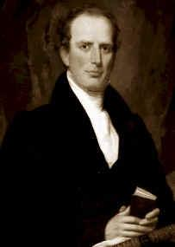
Revivalism = Charles Finney
He rejected the Calvinist doctrine of predestination
adopted ideas of free will and salvation to all
New form of revival
Meeting night after night to build excitement
Speaking bluntly
Encouraging women to testify in public

Slide 8
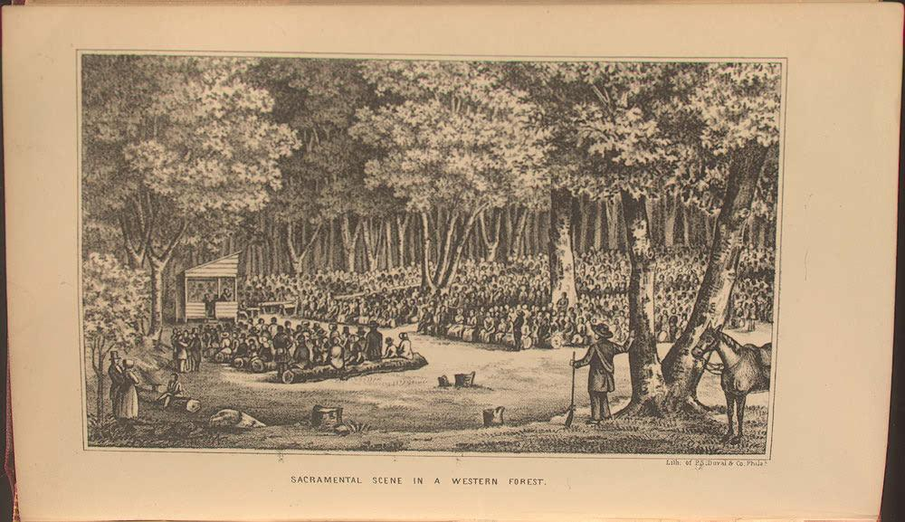

Slide 9
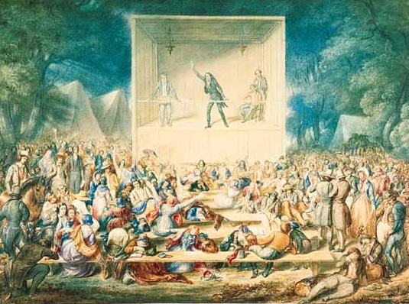

Slide 10
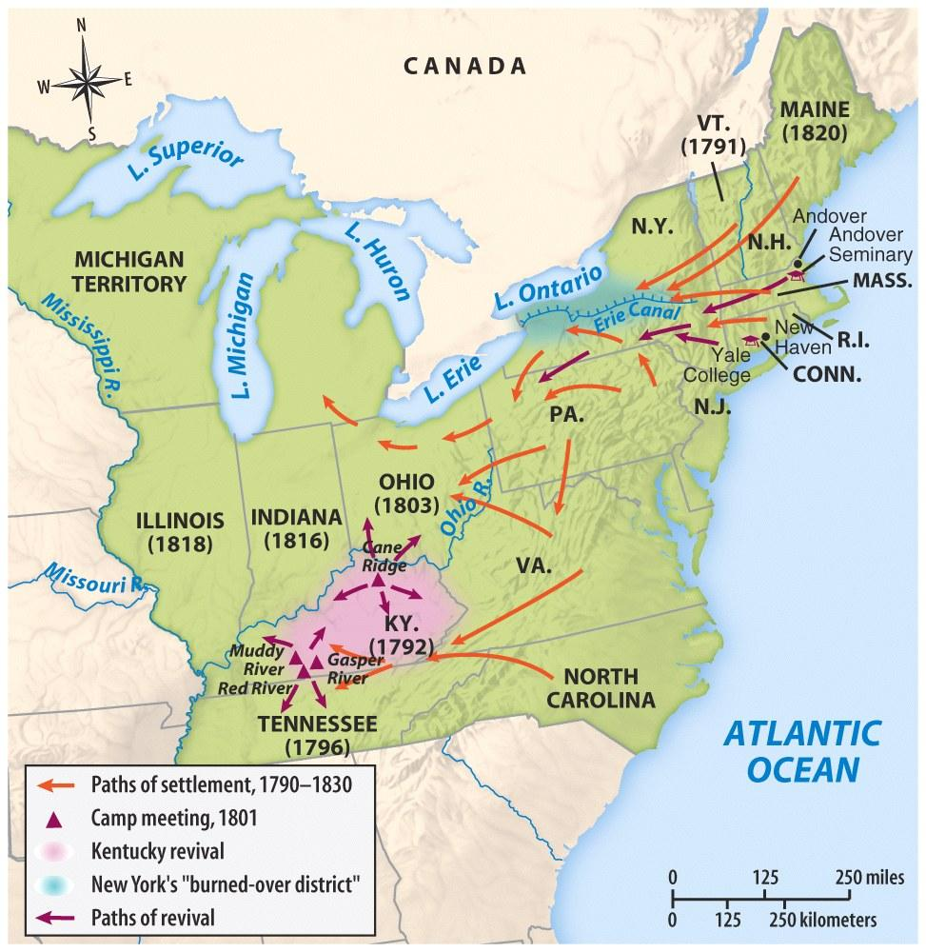

Slide 11
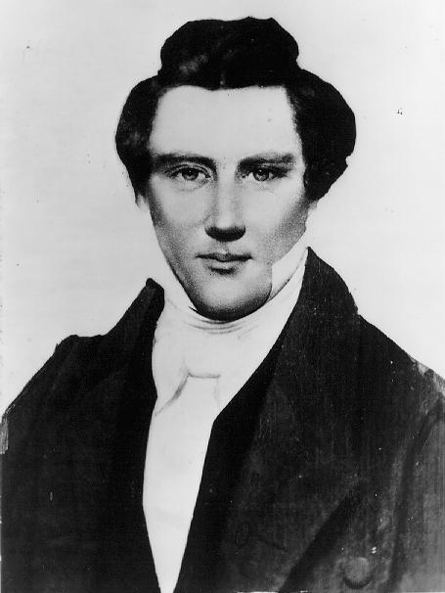
Mormons – The Church of Jesus Christ of Latter-Day Saints
While the Protestant revivals sought to reform individual sinners, others sought to remake society at large
Joseph Smith 1830
NY to OH to MO to IL
Murdered by mob in IL
Brigham Young leads to Utah
Practice cooperative socialism
Practices Polygamy

Slide 12
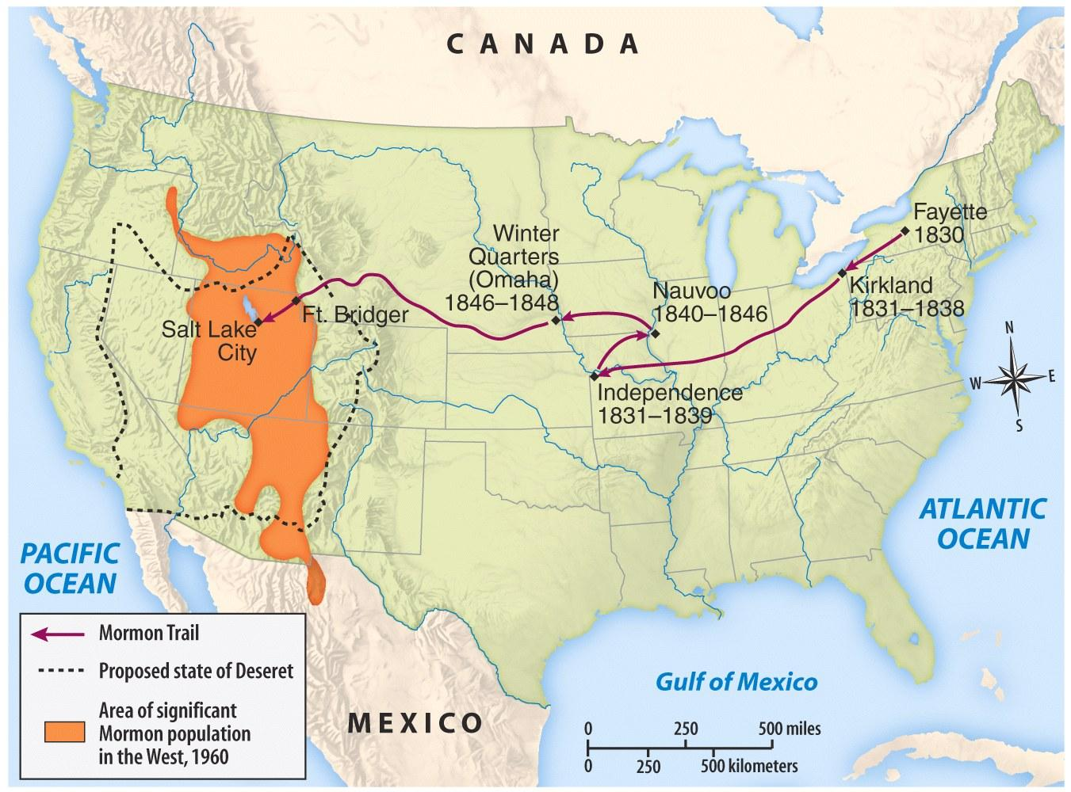

Slide 13
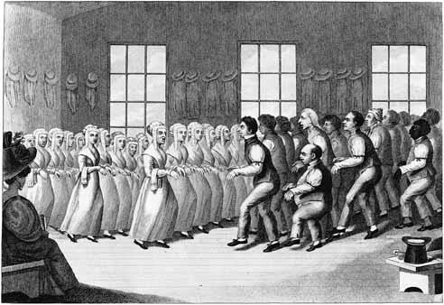
The Shakers
Ann Lee – 1774
The Shakers used dancing as a worship practice
Lacking any natural increase, membership began to decline after 1850, from a peak of about 6000 members

Slide 14
Shaker Meeting

Slide 15
Utopian Communities
The Oneida Community
Brook Farm
New Harmony
Transcendentalists
Notes:
*
The Oneida community (founded by John Humphrey Noyes)– opposite of the Shakers, “complex marriages and highly regulated group sex However men were not allowed to get women pregnant, only Noyes could do that. Today the Oneida Silverware Company is all that is left

Slide 16
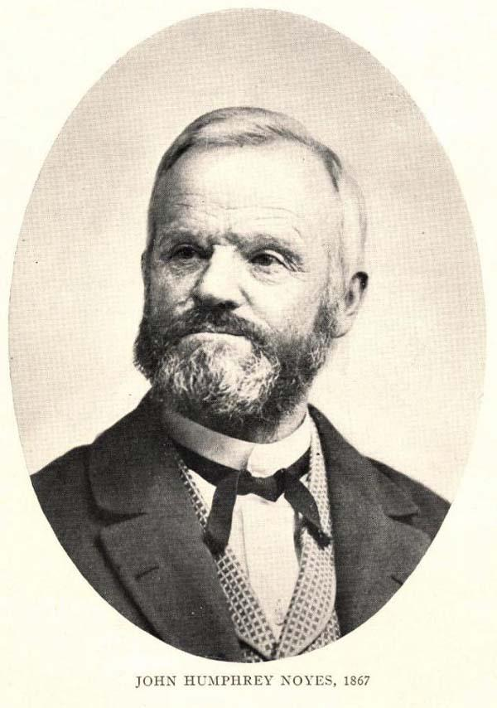
The Oneida Community New York, 1848
Millenarianism --> the 2nd coming of Christ had already occurred.
Humans were no longer obliged to follow the moral rules of the past.
all residents married to each other.
John Humphrey Noyes (1811-1886)
carefully regulated “free love.”

Slide 17
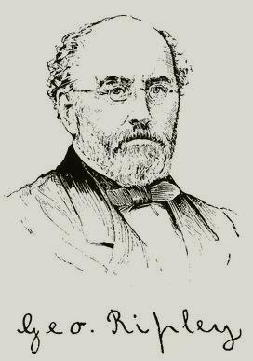
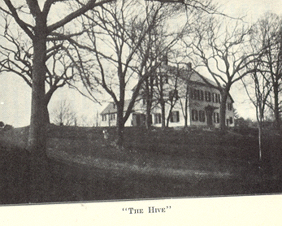
George Ripley (1802-1880)
Brook Farm West Roxbury, MA

Slide 18
Robert Owen (1771-1858)
Utopian Socialist
“Village of Cooperation”

Slide 19
New Harmony, IN

Slide 20
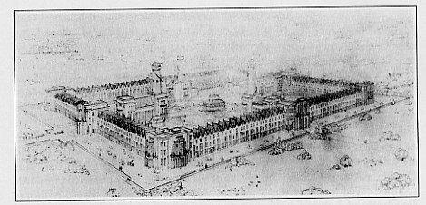
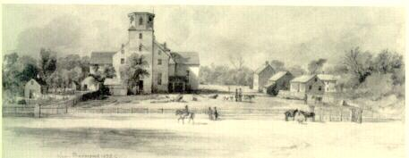
Original Plans for New Harmony, IN
New Harmony in 1832

Slide 21
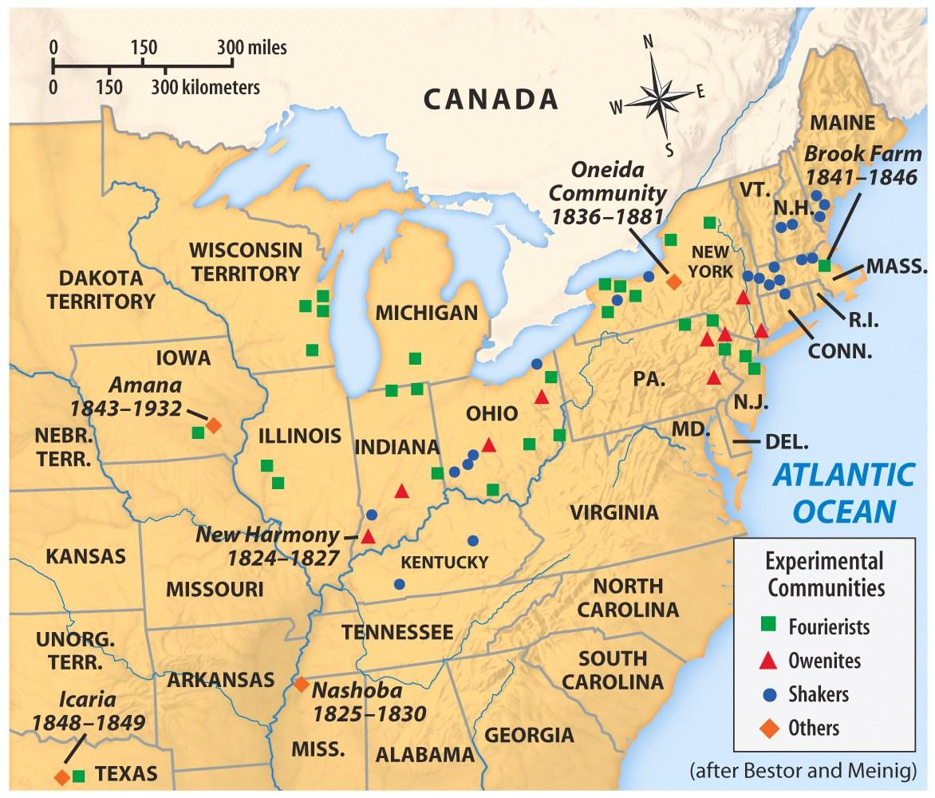

Slide 22
Transcendentalism
“Liberation from understanding and the cultivation of reasoning.”
“Transcend” the limits of intellect and allow the emotions, the SOUL, to create an original relationship with the Universe.

Slide 23
Transcendentalist Intellectuals/Writers Concord, MA
Ralph Waldo
Emerson
Henry David
Thoreau
Nature (1832)
Resistance to Civil Disobedience (1849)
Self-Reliance (1841)
Walden (1854)
“The American Scholar” (1837)

Slide 24
The Second Great Awakening
“Spiritual Reform From Within” [Religious Revivalism]
Social Reforms & Redefining the Ideal of Equality
Temperance
Abolitionism
Education
Asylum & Penal Reform
Women’s Rights

