Slide 1
American Nationalism
“Era of Good Feeling”

Slide 2
James Monroe Inauguration
“Never did government commence under auspices so favorable . . . If we look to the history of other nations, ancient, or modern, we find no example of a growth so rapid, so gigantic, of a people so prosperous and happy. In contemplating what we have still to perform, the heart of every citizen must expand with joy when he reflects how near our Government has approached to perfection . . . If we preserve in the career in which we have advanced so far and in the path already traced, we can not fail, under the favor of a gracious Providence, to attain the high destiny which seems to await us.”

Slide 3
President Monroe’s words emphasized the sense of national pride that swept the US after the War of 1812. For a time. Americans’ loyalty to the US overrode their historical identity with state or region. The Columbian Centinal, a Boston newspaper, declared this time to be an Era of Good Feeling. The phrase has since been used to describe the Monroe Presidency.
Harmony in the national politics had reached a new high mostly because only one major political party – Republicans- had any power. The Federalist Party had lost political influence and popularity, in part because of the public’s disapproval of their actions at the Hartford Convention. At the same time, the War of 1812 had taught a new generation of Republican leaders that a strong Federal government was advantageous

Slide 4
Economic
1. Second Bank of the US
First bank ended in 1811 = disaster
1816 create new bank – regulate prices, money, and loans
2. Tariff of 1816
Protective tariff – raise prices of cheap foreign goods after war to help American businesses
Supported by South because suppose to be temporary (3yrs),
3. Transportation
John C Calhoun proposed federal building of roads, canals, etc
Blocked by Monroe because not enumerated power
Better transportation would increase flow of goods, size of markets which would help the economy.
*Republicans have firm control of the politics and are willing to experiment with ideas that were once considered Federalist.

Slide 5
Judicial
1. Martin V Hunter’s Lessee
VA court upheld confiscation of land from a loyalist saying Supreme Court has no authority over cases starting in States
Supreme Court overruled VA and asserted ultimate Supreme Court authority over state courts
2. McCulloch V Maryland
MD taxes banknotes from Bank of US
Supreme Court sides with BUS, establishing congress right to use implied powers and state cannot interfere with federal institution
3. Gibbons V Ogden
legality of a steam ship monopoly granted by state of NY covering route from NJ to NY.
Supreme Court held that power to regulate interstate commerce was granted to Congress by the Commerce Clause
*reaffirms that national government has supreme power over states

Slide 6
Diplomatic
1. Adam-Onis treaty (1819)
First Seminole War – A. Jackson invades Florida over Native American attacks in Georgia
Treaty creates clear boundaries between US and Spanish territory and give US control of Florida
2. Quadruple Alliance (1815)
European empires band together to protect their monarchies
United Kingdom, Austria, Prussia, and Russia (France 1818)
3. Monroe Doctrine
Fear Quadruple alliance helping Spain regain control of empire in the America’s
Attempts to colonize the Americas would be viewed as an attack on US
British help enforce, want to ensure Britain can continue to trade with Latin America
* Initial impact is Isolationism but sets up the ground work for US role as “big brother” in Latin America

Slide 7
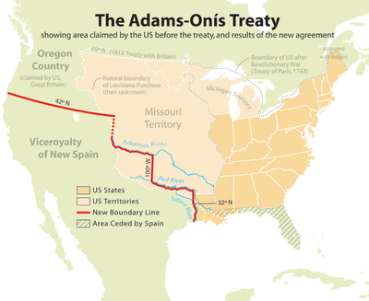

Slide 8
