Slide 1
Battles of The Civil War

Slide 2
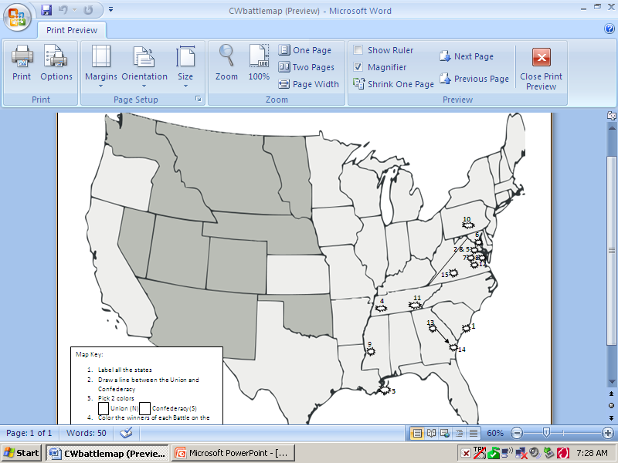

Slide 3
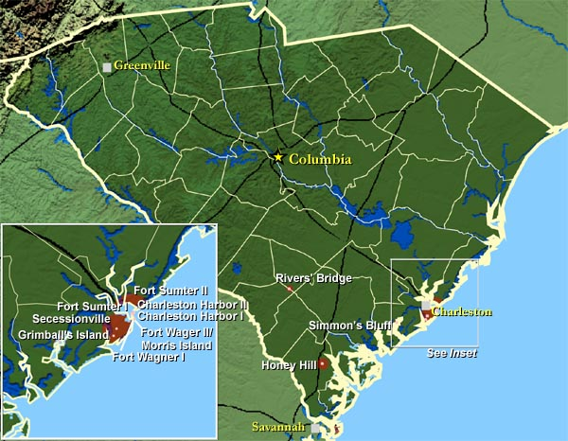
1.Fort Sumter
Lincoln cannot allow Confederates to control Union property
Confederates try to take control of fort before reinforcements arrive
Battle last 33 hrs before Union surrenders
Civil War has begun

Slide 4
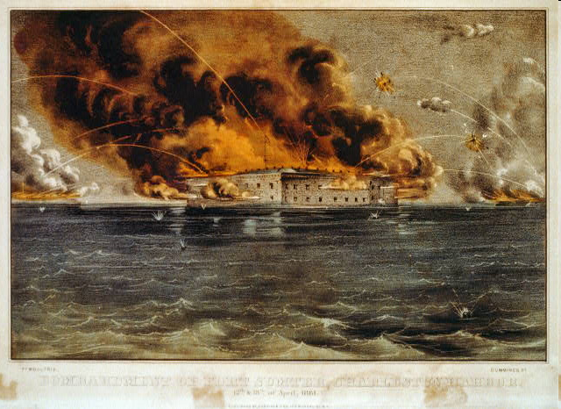
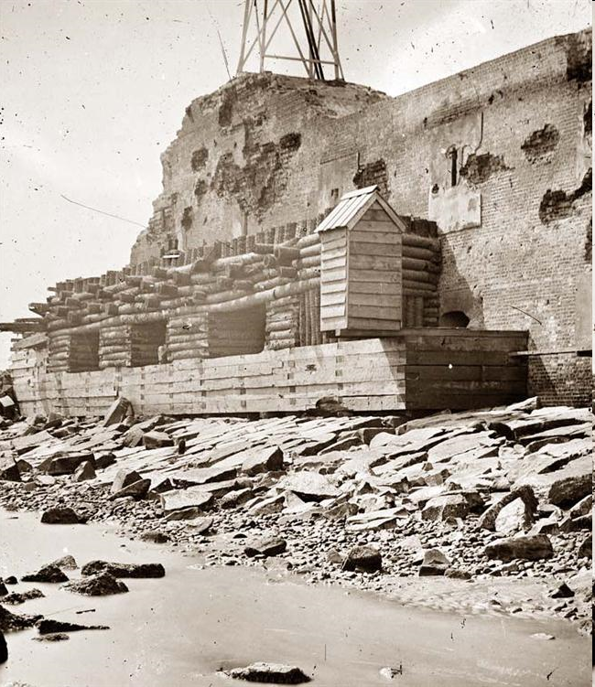

Slide 5
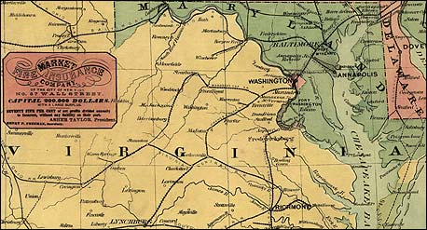
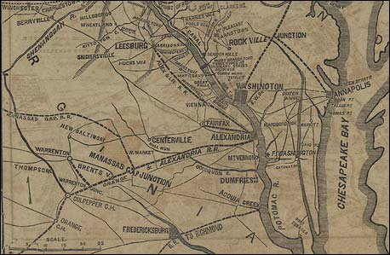

Slide 6
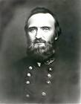
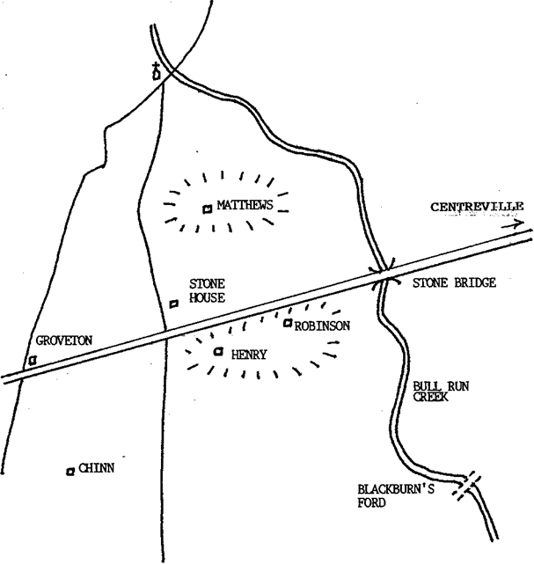
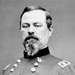
2. 1st Battle of Bull Run (Manassas)
July 21, 1861
Confederate forces (Gen. Stonewall Jackson) get the upper hand
Union (Gen. Irwin McDowell) panicked and ran
All hope of a quick war vanishes, create myth of invincible south

Slide 7
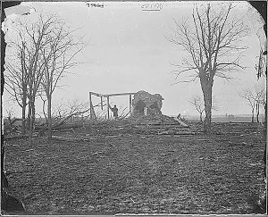
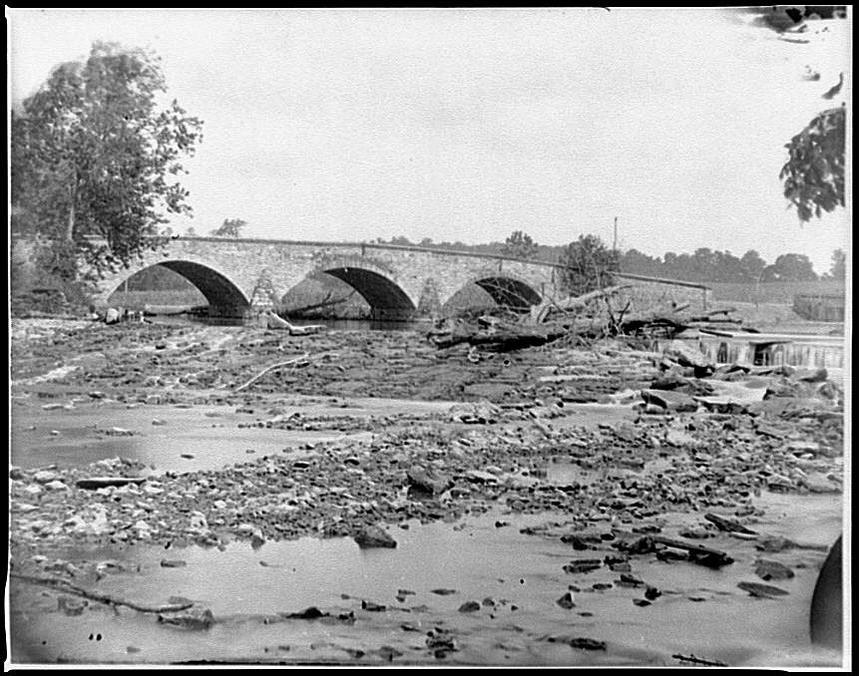

Slide 8
3. Naval War/New Orleans
By Spring 1862 Union blocked most ports
Union ships could not stop all Blockade Runners
Union (Farragut) captures New Orleans
One step closer to controlling MS River

Slide 9
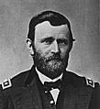
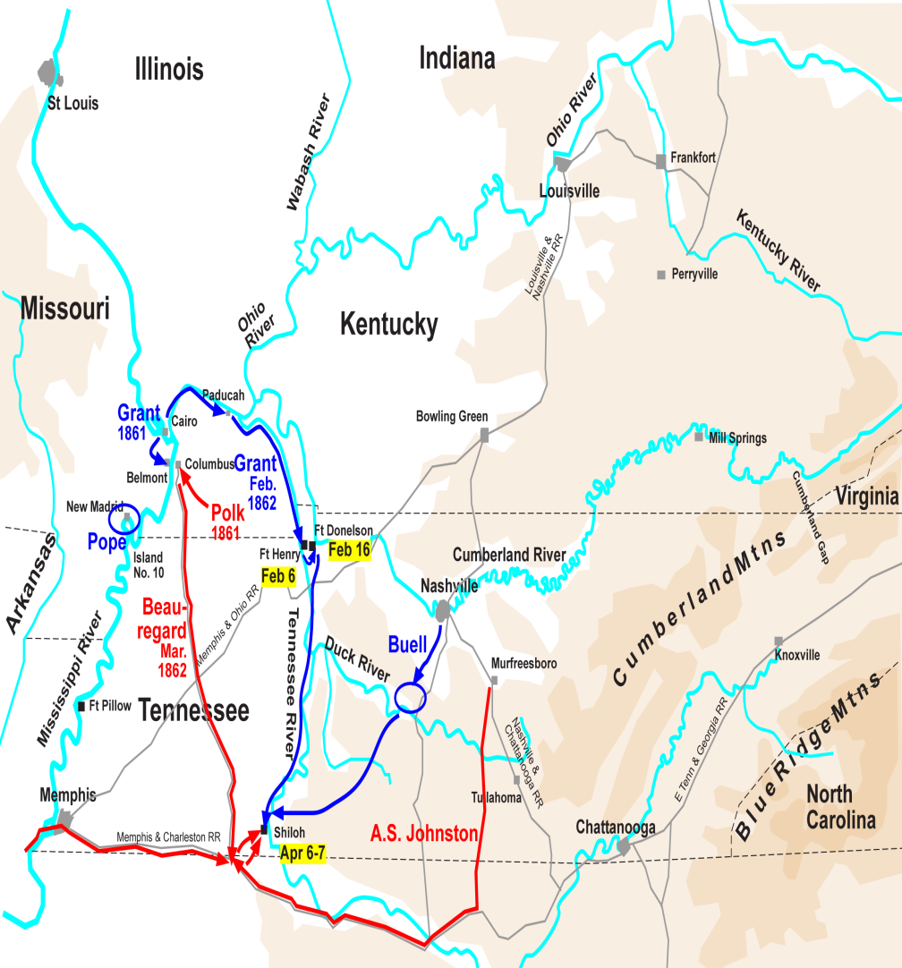
4. The Battle of Shiloh
April 6-7 1862
Union (Gen Ulysses S. Grant) campaign to capture Tennessee and Cumberland River
Confederates launch surprise attack
Union is able to win, but 20,000 wounded or killed
Solidify Union’s army dominance in West

Slide 10
5. 2nd Battle of Bull Run
Aug 29-30, 1862
Union (Gen. George McClellan) want to capture Richmond
McClellan allows troops to be divided
Confederates (Gen. Robert E. Lee)
attacks, Confederates 20 Miles from DC (Bull Run)

Slide 11
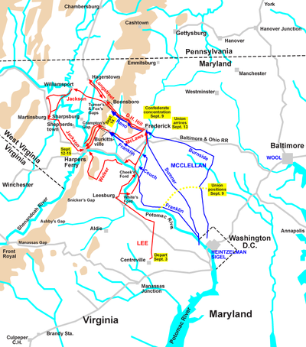
6. Battle of Antietam
Sept 17 1862
Confederates and Lee invade Maryland
Union (McClellan) force Confederacy to retreat, but doesn’t pursue (Replaced by Burnside)
Confederacy loses chance to gain support
Bloodiest one day battle (22,000)
Paves way for Lincolns Emancipation Proclamation

Slide 12
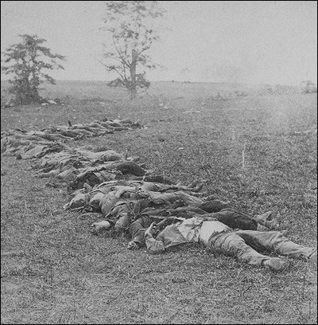

Slide 13
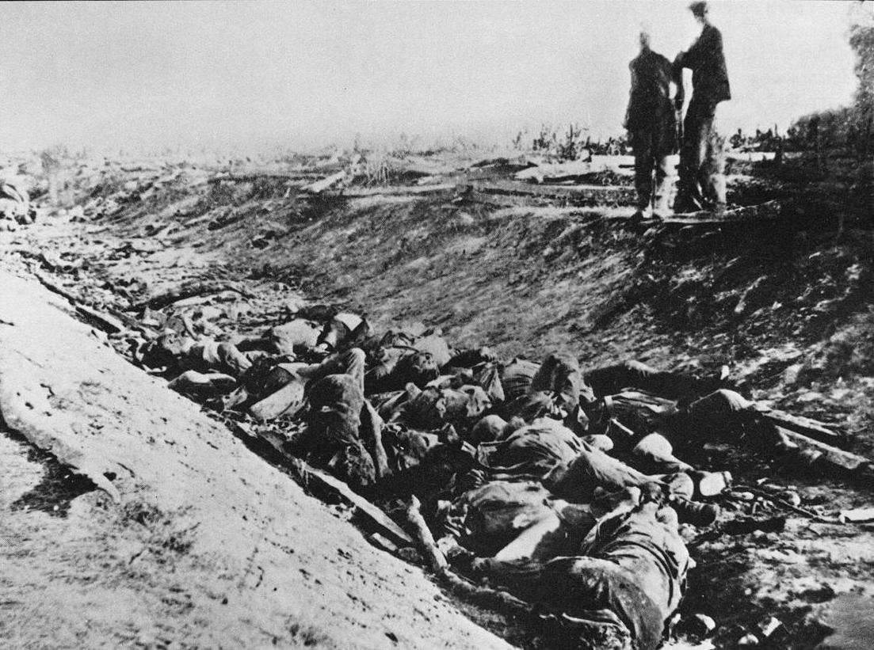

Slide 14
Emancipation Proclamation
That on the 1st day of January, in the year of our Lord 1863, all persons held as slaves within any state or designated part of a state, the people whereof shall then be in rebellion against the United States, shall be then, thenceforward, and forever free; and the executive government of the United States, including the military and naval authority thereof, will recognize and maintain the freedom of such persons and will do no act or acts to repress such persons, or any of them, in any efforts they may make for their actual freedom.
That the executive will, on the 1st day January aforesaid, by proclamation, designate the states and parts of states, if any, in which the people thereof, respectively, shall then be in rebellion against the United States; and the fact that any state or the people thereof shall on that day be in good faith represented in the Congress of the United States by members chosen thereto at elections wherein a majority of the qualified voters of such states shall have participated shall, in the absence of strong countervailing testimony, be deemed conclusive evidence that such state and the people thereof are not then in rebellion against the United States.
Now, therefore, I, Abraham Lincoln, President of the United States, by virtue of the power in me vested as commander in chief of the Army and Navy of the United States, in time of actual armed rebellion against the authority and government of the United States, and as a fit and necessary war measure for suppressing said rebellion, do, on this 1st day of January, in the year of our Lord 1863, and in accordance with my purpose so to do, publicly proclaimed for the full period of 100 days from the day first above mentioned, order, and designate as the states and parts of states wherein the people thereof, respectively, are this day in rebellion against the United States. . . .
And, by virtue of the power and for the purpose aforesaid, I do order and declare that all persons held as slaves within said designated states and parts of states are, and henceforward shall be, free; and that the executive government of the United States, including the military and naval authorities thereof, will recognize and maintain the freedom of said persons. . . .
And upon this act, sincerely believed to be an act of justice, warranted by the Constitution upon military necessity, I invoke the considerate judgment of mankind and the gracious favor of Almighty God. . . .

Slide 15
Emancipation Proclamation (9/1862)
All states in Rebellion (confederacy), frees 0 slaves
If they don’t have representatives in Congress
“fit and necessary war measure”, way to suppress rebellion
Government and armed forces
Constitution gives him power as a military necessity
Changed Civil War from conflict to preserve union to a war to free the slaves

Slide 16
7. Fredericksburg
Dec 13,1862
Union General Ambrose Burnside attacks Lee troops
Union suffers 12,000 causalities
Burnside replaced by General Joseph Hooker
* By end of 1862, no prospect of victory for either side

Slide 17
8. Chancellorsville
May 2, 1863
Union Gen Joseph Hooker tries to surround Lee’s troops in VA
Lee divides his troops and attacks Union first
Confederates (Lee) wins but Gen Stonewall Jackson dies

Slide 18
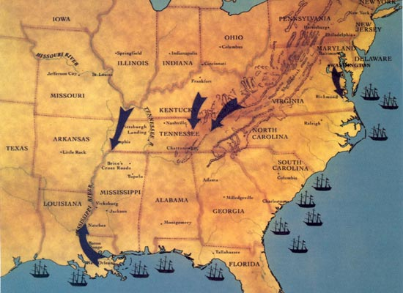

Slide 19
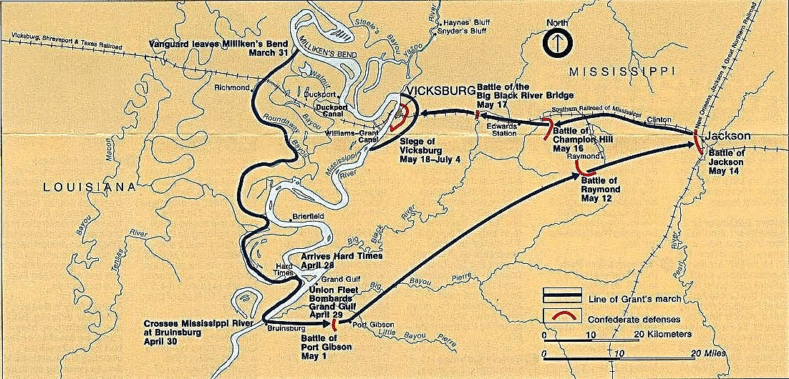
9. Vicksburg
May 1863 Grant attacks Vicksburg
Attacks unsuccessful
Grant laid 47 day siege; cut of food, bombard city
July 4th 1863 Confederates surrender
Union cuts Confederacy in two (Anaconda Plan)

Slide 20
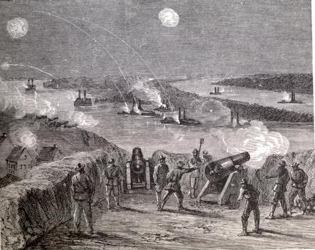
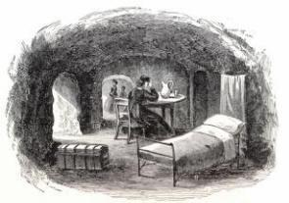

Slide 21
10. Gettysburg
July 1-3 1863
Hooker replaced by George Meade
July 3rd Pickets Charge - 15,000 Confederates attack Union on Cemetery Ridge = 7,000 dead in a ½ hr
Union Victory – 23,000 dead, South 28,000
Turning Point – Confederacy loses chance of British aid forever, remain on defensive for rest of war.

Slide 22
11. Chattanooga
Nov 1863
Confederate forces were driven out of Tennessee
Union in control of major RR junction and a straight line into Atlanta (Anaconda Plan)
Grant becomes General in Chief for the Union army

Slide 23
12. Wilderness to Cold Harbor
Series of attacks in VA to distract Lee from Sherman’s march on Atlanta
Wilderness – two days no pausing
Spotsylvania – 11 days, hand to hand
Cold Harbor – Grant stopped by Lee, but Grant did buy Sherman time
Union much more causalities

Slide 24
13. Atlanta
Sept 1864 1/3 of Atlanta burned
Fall of Atlanta helps Lincoln secure re-election in 1864 against McClellan
Lincoln passes 13th Amendment = no slavery

Slide 25
14.Sherman’s March to the Sea
November 12, 1864, Sherman marched out of Atlanta toward the Atlantic coast
sixty-mile wide swath of destruction in the Confederacy's heartland

Slide 26
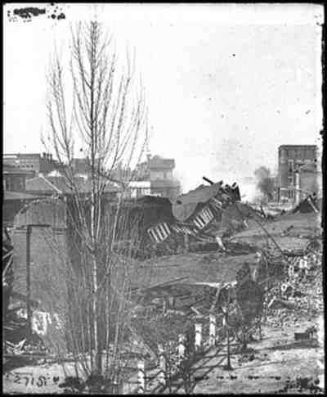
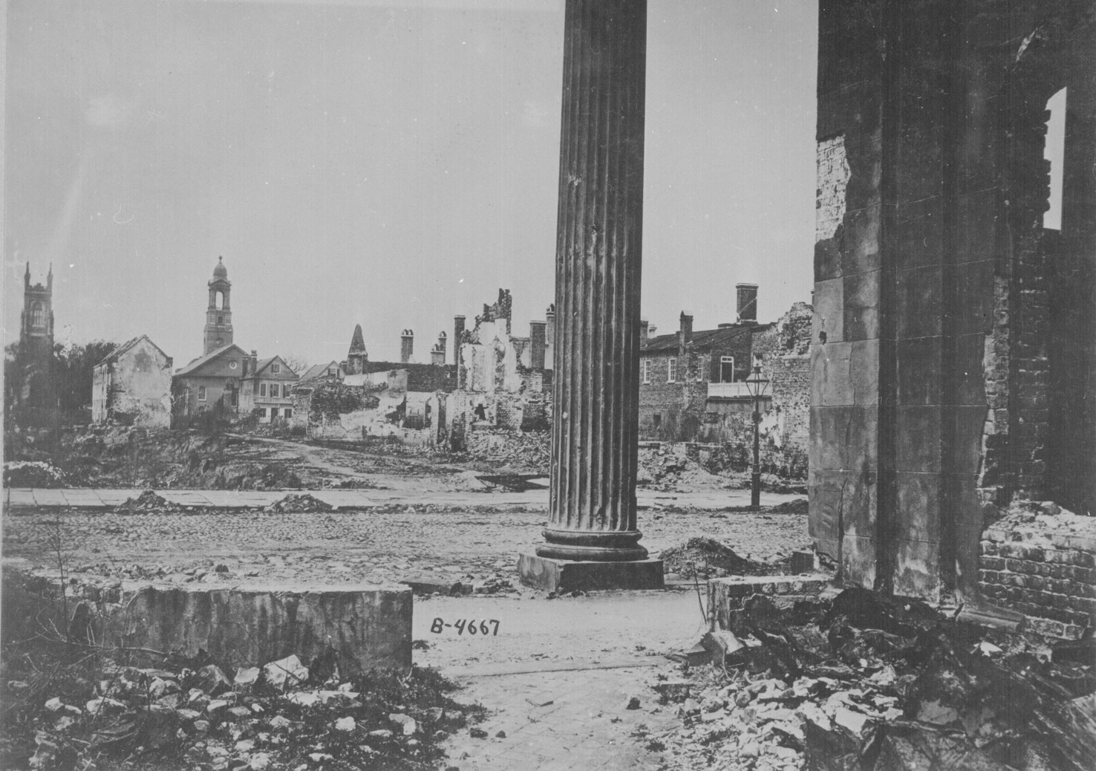

Slide 27
15. Appomattox Courthouse
Lee tries to escape from Grant during the Siege of Petersburg
Lee surrenders to Grant on April 9, 1865 = Civil War over
Generous terms of surrender for Confederates
No one prosecuted for treason
Allowed to take horses home (farmers)

Slide 28
Legacy of the Civil War Impact on US
13th Amendment = ends slavery
How to reunite Country = Reconstruction
Strengthen Federal government
States cannot leave Union
Constitution works

Slide 29
Legacy of the Civil War Impact on South
Economically destroyed
RR destroyed, towns/farms/factories ruined
Replace slaves, what will happen to Cotton Industry
Socially devastated
Lost large % of young men (320,000)
Politically
Democrats weaken
Federal government stronger then states
North in charge of Reconstruction

Slide 30
Legacy of the Civil War Impact on North
Economically
Became more Industrial
More people work for RR then farms
New Technologies were created
-Socially
Immigrants come for opportunity
Lost 385,000
Political
Republicans in charge

