Slide 1
Do Now: What are the Three Branches of Government called?
Objectives: Students will be able to...(1) identify important constitutional powers from the Constitution (2) analyze a primary source for information
Homework: Read article for Presentation

Slide 2
Create this chart in your notes:
Executive | Legislative | Judicial

Slide 3
Put these powers in their respective columns
Makes/Passes Laws
Signs or Vetoes
Pardons people
Decides if laws are Constitutional
Negotiate treaties
Coin/Create Money
Impeach the President
Recommend Legislation/Laws
Supervise decisions made by other Federal Courts
Control the budget
Declare war/sign treaties
Carries out laws that are passed
Appoint Ambassadors/Supreme Court/Cabinet Heads (With approval)

Slide 4
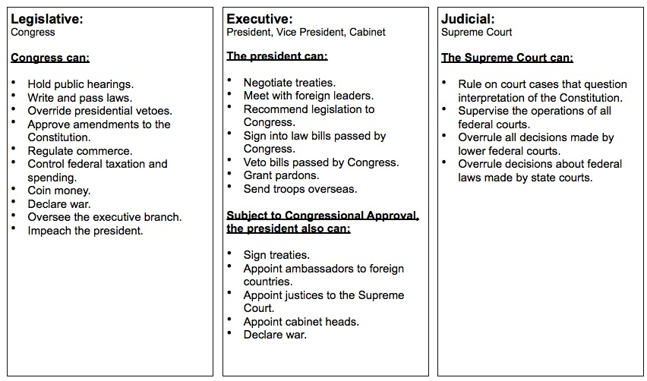

Slide 5
Scenario 1
Homeland security officials have been ordered to open suspicious packages they believe might be from terrorists.

Slide 6
Scenario 2
A bill was recently passed to allow citizens to choose their own health care plan under Medicare.

Slide 7
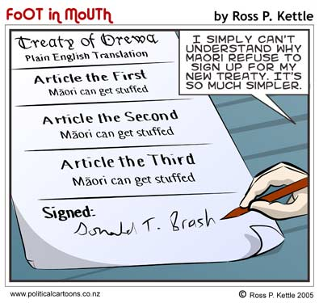
Scenario 3
The United States has negotiated a peace treaty with Iran

Slide 8
Scenario 4
A law recently passed in a state legislature banning gay marriages is being challenged as unconstitutional

Slide 9
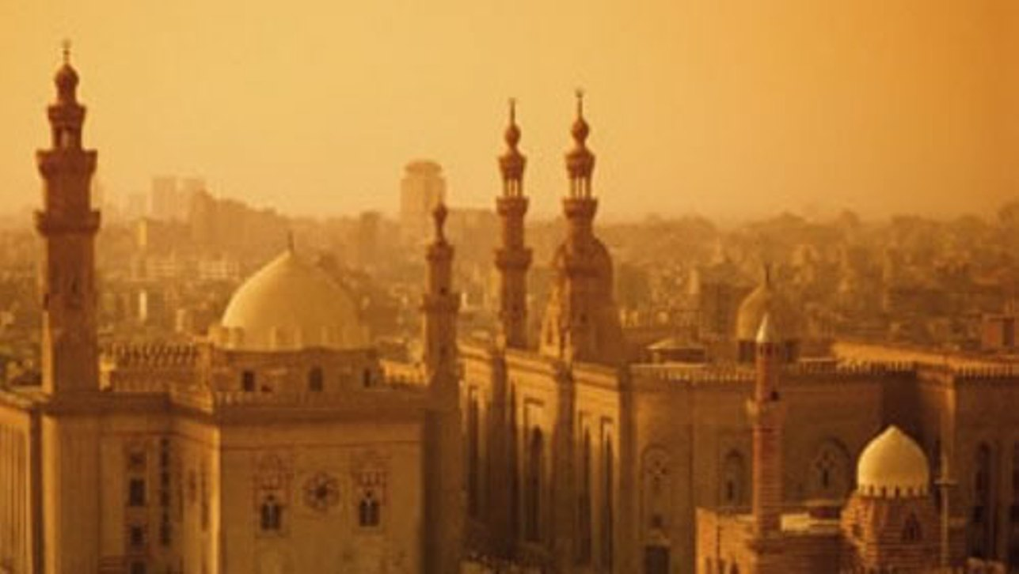
Scenario 5
A Bill is passed outlawing American citizens from making contributions to charitable organizations from the Middle East

Slide 10
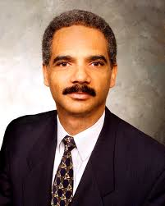
Scenario 6
A replacement for the Attorney General has been given to congress

Slide 11
Scenario 7
A recent bill to increase funding for education was passed over the president’s rejection of the bill.

