Slide 1
CH 7 Review

Slide 2
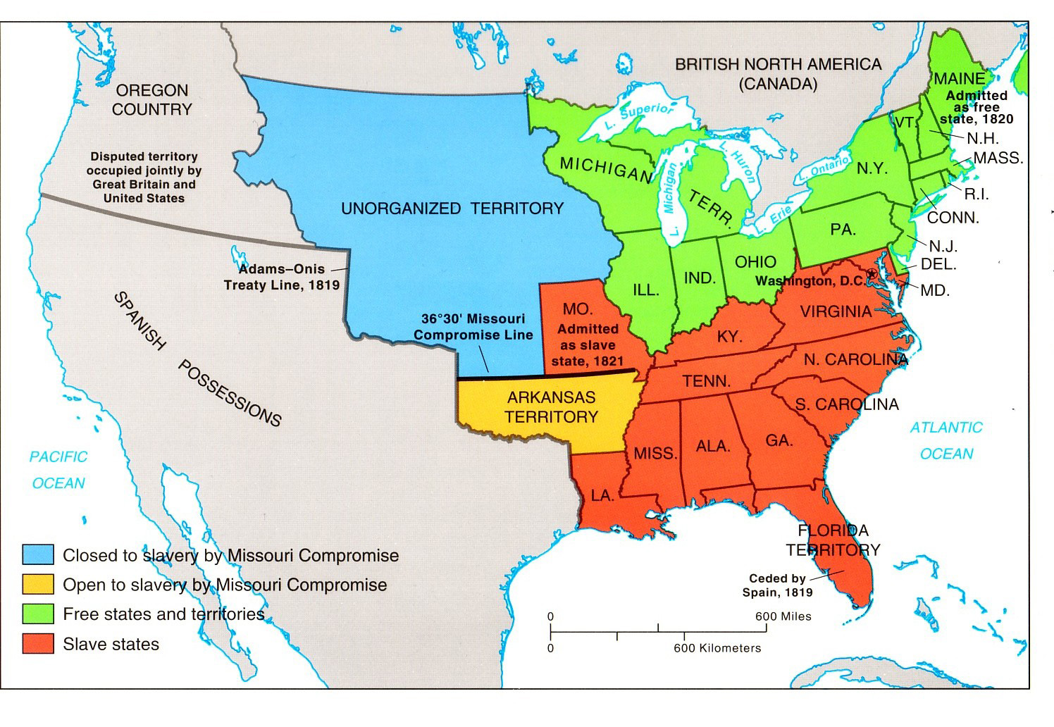
1. MO Compromise Line 2. Missouri and Maine added 3. Florida added by Adam Onis Treaty

Slide 3
1-7 Presidents
George Washington
John Adams
Thomas Jefferson
James Madison
James Monroe
John Quincy Adams
Andrew Jackson

Slide 4
Diplomatic Policy
Monroe Doctrine
Fearful the Quadruple alliance may attempt to take back Spanish Colonies
The America’s were closed to colonization and any attempt by the European powers would be seen as an attack on the United States

Slide 5
Economic Policy
Recreate Bank of the United States to handle finances
Tariff of 1816 to protect American businesses from cheap British imports
American System to improve transportation

Slide 6
Judicial Policy
John Marshall
McCullough V MD; Gibbons V Ogden; Hunter V Lessee
Federal government stronger then state

Slide 7
Industrial Revolution
National Road
Albany to Buffalo NY
Cotton Gin
More cotton grown in south creates boom in their economy, same time provides enough cotton for the growing textile miles in the North

Slide 8
Inventions Industrial Revolution
1. Steamboats
Carry cargo upstream
S & N can moves and receive goods cheaper and faster.
Helps farmers along Mississippi River
2. Cotton Gin
picks seeds out of cotton
S = produce cotton faster N = lowers price of cotton
3. Railroads
More Railroads in the North, connect and create major cities, allows for more growth and connections with the West
Helps move product quicker and faster
4. Telegraph
Allows for widespread communication
Connects North and South with the West
5. Factories
Increases demand for Sothern crops
Increased population in the North due to immigration, etc helps full the growth of Factories and cities
Allows for goods to be made quicker and cheaper for the North and South
6. Mechanical Reaper
Allows the South to clear crops faster, can plant larger fields with less help. New Technology will increase crops and lower prices, but new technology expensive putting many farmers into debt
North and West can get crops/food for less

Slide 9
Planter , 20 or more slaves
Yeoman, 4 or less slaves
Rural Poor
African Americans
Gang and Task
Passive aggressive behavior, runaway, revolt, create culture

Slide 10
Missouri Compromise
Missouri wanted to be a slave state and would upset the balance in the senate in favor of slave states
States need to be admitted in pairs to keep balance. MO becomes slave and ME becomes Free.
Creates a line dividing the country between slave and free

Slide 11
Elections
Election 1824
Election 1828
John Quincy Adams
Andrew Jackson
William Crawford
Henry Clay
Andrew Jackson
John Quincy Adams

Slide 12
Corrupt Bargain
Election 1824
Henry Clay as Speaker of the House uses his influence to make John Quincy Adams President in exchange for him being named Secretary of State.

