Slide 1
Ch 8 Review

Slide 2
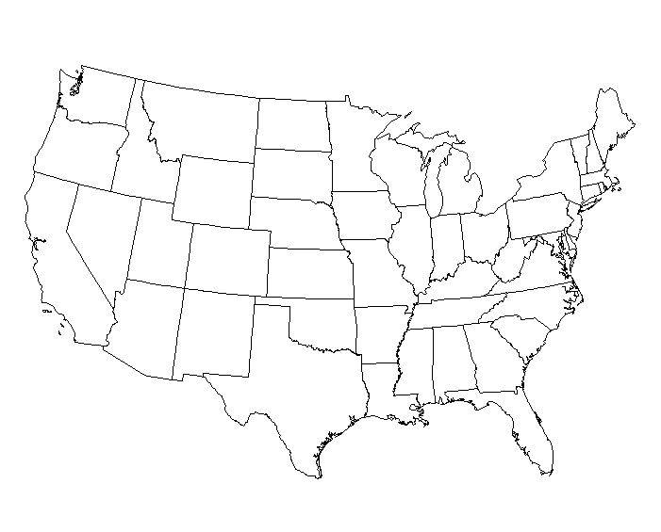

Slide 3
Presidents
G. Washington
J. Adams
T. Jefferson
J. Madison
J. Monroe
JQ Adams
A. Jackson
M. Van Buren
WH Harrison
J. Tyler

Slide 4
Events
Van Buren = Panic of 1837
Jackson = Indian Removal Act
Tyler = Annex Texas
Van Buren = Trail of Tears
Harrison = Dies in Office
Jackson = Survived assassination
1st modern – use of veto and making President most powerful office

Slide 5
 | Whigs | Democrats
Leader | Henry Clay, WH Harrison, Daniel Webster | A Jackson, M Van Buren
Region | North | South
Tarrifs | Pro Protective Tariffs | Anti Protective Tariffs
Slavery | Don’t want it to expand | Protect slavery
Paper money | favor | Gold/silver
American System | Federal government funded | State government funded

Slide 6
Reformers
Dorethea Dix – Prison – separate people according to crime/mental issue
William Llyod Garrison – Abolitionism – slavery viewed as inhuman
Elizabeth Cady Stanton – Women’s rights – little to no rights, dependent on men
Horace Mann – education – educate workers, immigrants, voters
Lyman Beecher – Temperance – alcohol consummation at all time high, seen as causing crimes, etc

Slide 7
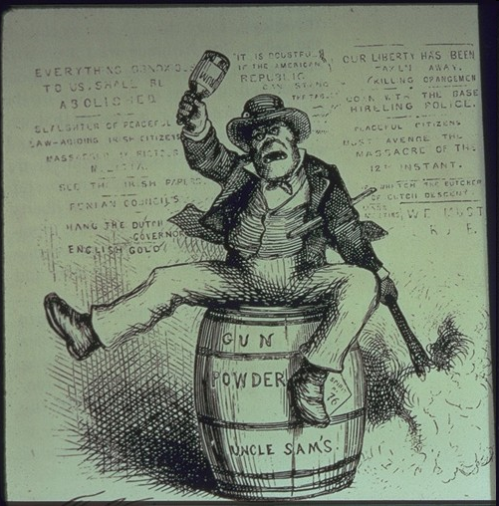
Irish
As monkey – seen as not as civilized as Americans, drunk en animals
Hostility to foreigners shown in treatment of the Irish

