Slide 1
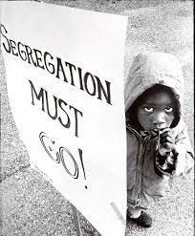
Do Now: Grab a worksheet and do the ‘Do Now’
Objectives: Students will be able to...(1) explain further means of resistance (2) analyze a primary source for key information.
Homework: Continue Work on Project (Due April 4 NOW)

Slide 2
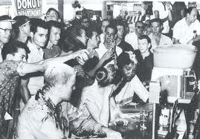
Greensboro Sit-ins
Movement started with 4
Within 2 months: 54 Cities, 9 States
Allowed students to take matters into own hands
https://www.youtube.com/watch?v=Xbbcjn4d1cE (Woolworth Counter)

Slide 3
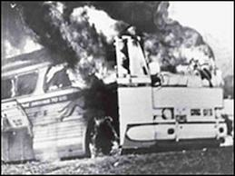
Freedom Riders
Interstate bus travel still segregated in the South
Groups organized to draw attention
Met by angry mobs
Beat and bloodied riders (rocks, bats, chains, lead pipes, etc.)
Even set fire on busses
http://www.youtube.com/watch?v=1zBY6gkpbTg (Freedom Riders)

Slide 4
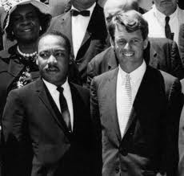
JFK & Civil Rights
Actively Supported Civil Rights
Cautious once in office
Named 40 AA Members to high level positions
Created CEEO (Committee on Equal Employment Opportunity)

Slide 5
Acts of Violence
James Meredith – Transferred to University of Miss.
Governor blocked transfer
JFK sent 500 Marshalls
Angry mob attacked Marshalls (160 injured)
JFK sent several thousand troops to escort to class
Violence in Birmingham
MLK believed government would only intervene if there was violence
Organized Protest – Sent to Jail
Wrote “Letter from Birmingham Jail” – Defense of non-violent protest

Slide 6
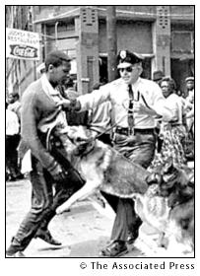
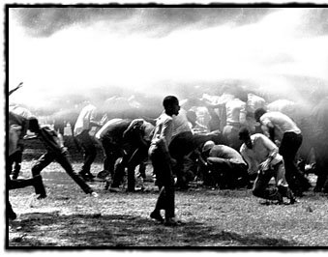

Slide 7
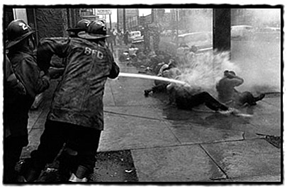

Slide 8
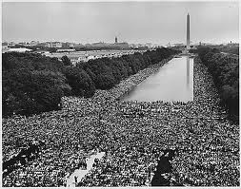
Civil Rights Act of 1964
JFK Introduced in June of 1963
Declared it a “Moral Issue”
TURNING POINT IN MOVEMENT – March on Washington DC
200,000 demonstrators
MLK’s “I Have a Dream” Speech
http://www.youtube.com/watch?v=j5RIKuH3tXM (March on Washington)

Slide 9
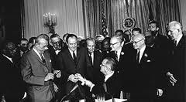
Passage of the Act
Senators filibuster (Refusal to stop debate)
Can motion for cloture (Forcing a vote)
Lyndon Johnson took over after JFK – Pushed Civil rights Act
Got the votes needed in House and Senate
Most comprehensive Civil Rights bill ever:
Segregation illegal in most places
Equal access to facilities (restaurants, theaters, libraries, etc.)
Power to bring more lawsuits
End discrimination in workplace

