Slide 1
Today’s Topic:
The American Dream
Scarface =
a lesson on how not to pursue
the American Dream
Modern Times =
a different kind of lesson about the
American Dream

Slide 2
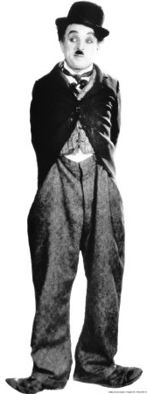
The “Tramp” played by
Charlie Chaplin
Factoid:
Most recognized
Fictional image
of a human
in the history of art.

Slide 3
Walking Contradictions
Baggy Pants
Too Tight Jacket
Big Shoes
Little Hat
Working Man
Trying to be
High Society

Slide 4
The Tramp
Is a childlike, bumbling but overall good-hearted character
Presented as a vagrant
Tries to behave with the manners of gentleman despite his social status
Ready to take whatever paying work that is available but also uses cunning to get what he needs to survive and to escape the authorities

Slide 5
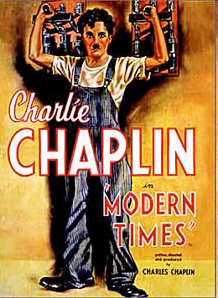
Modern Times
-1936-
“Unemployment is the vital
question…
Machinery should benefit
mankind.
It should not spell tragedy
and throw it out of work.”

Slide 6
The Tramp (Little Fellow)
Tramp = survives because of his/her whit
does not consistently work
another ex: Lady and the Tramp
Hobos= “transient worker”, travels looking
for work
Bums = do not look for work, do not travel

Slide 7
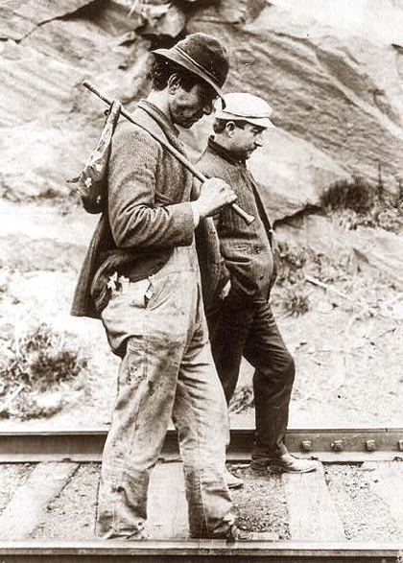
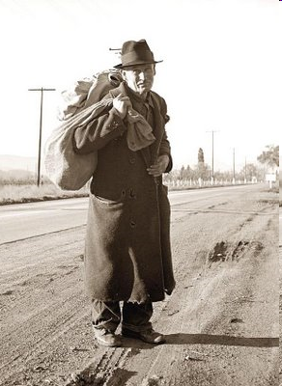

Slide 8
His creation was ‘many-sided,’ Chaplin said, ‘a tramp, a gentleman, a poet, a dreamer, a lonely fellow, always hopeful of romance and adventure…not above picking up cigarette butts or robbing a baby of its candy.’
‘it heightens our sense of survival and preserves our sanity…because of humor we are less overwhelmed by the vicissitudes of life.’
He dramatized how today’s working man too easily becomes tomorrow’s homeless tramp, the opening concept in Modern Times…

