Slide 1
Civil War Secession Map

Slide 2
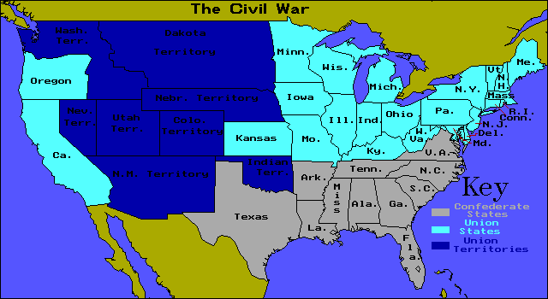

Slide 3
South Carolina
11 – South Carolina, North Carolina, Virginia, Arkansas, Tennessee, Texas, Louisiana, Mississippi , Alabama, Georgia, Florida
Jefferson Davis
Each state was independent, guarantee slavery, banned protective tariffs, and president limited to single six year term
Abe Lincoln
Not to interfere with slavery & protect federal property in all states

Slide 4
7. 5 = West Virginia, Maryland, Delaware, Missouri, Kentucky
8. West Virginia & Delaware comes into Union on its own
Martial law (military control) is declared in Maryland
Kentucky tries to be neutral but Confederate forces invade so they join Union
Missouri has power struggle between pro and anti-secession forces, Union troops help keep it in the Union

