Slide 1
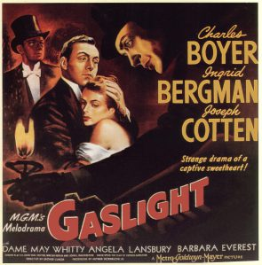
Gaslight
Today:
What is the film noir genre?
Start watching “Gaslight”

Slide 2
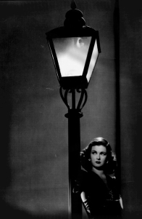
Film Noir
French for “black cinema”
A term used post WWII to describe early 1940s movies that were cynical and had dark themes

Slide 3
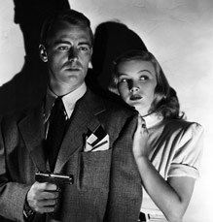
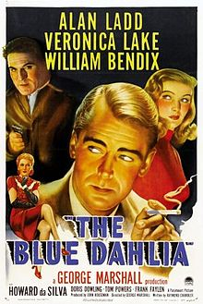
Elements of Film Noir #1: WWI & post-war disillusionment
Move from propaganda films (meant to cheer people’s outlook of hard times during WWII) to disillusionment of women losing jobs at end of war & men returning home
“The Blue Dahlia ”
sailor comes home from WWII to find his wife kissing another man and their son dead due to her drunkenness

Slide 4
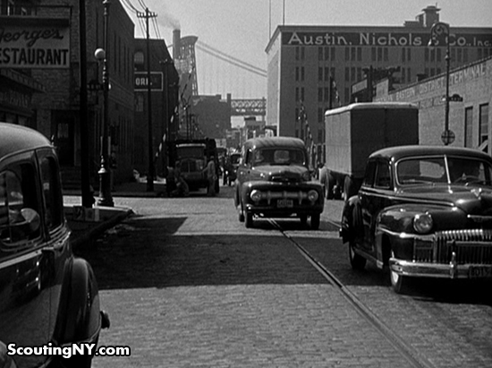
Elements of Film Noir #2: Post-war realism
Americans wanted to see a harsh view of society from the perspective of everyday people on the streets and watch actors in actual locations

Slide 5
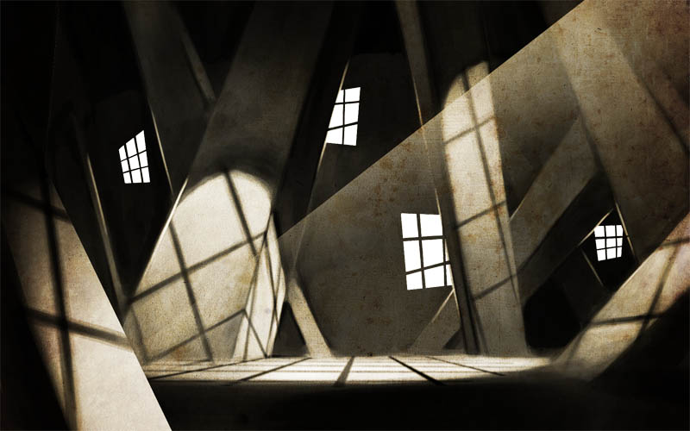
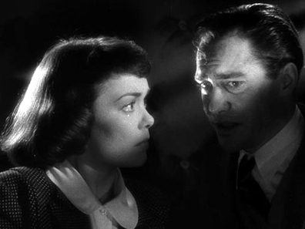
Elements of Film Noir #3 & 4: German influence & hard-boiled tradition
3) German influence
Helped film industry with aesthetics during 1930s immigration
Expressionist lighting (using artificial studio lighting to create shadows, oblique and vertical lines, and irregular light patterns)
4) Hard-boiled tradition (literary genre)
Similar to crime fiction, especially detective stories
Authors whose books turned into film noir

Slide 6
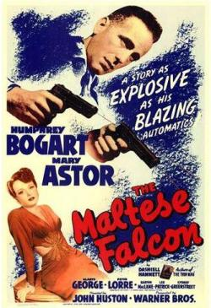
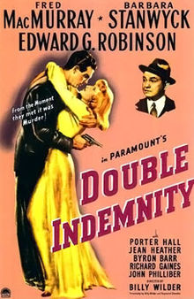
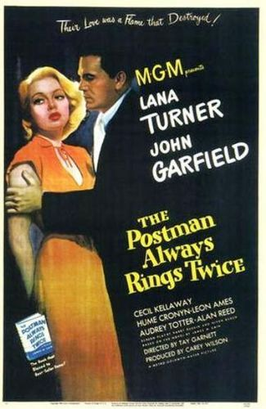
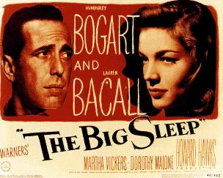
Most well-known film noir from fiction
Double Indemnity
The Maltese Falcon
The Big Sleep
The Postman Always Rings Twice

Slide 7
Film Noir Characteristics found in “Gaslight”
Scenes appear dark, as if lit for night, with many dark shadows
Stark, angular shadows
Urban environment
Rain-soaked streets
Hopelessness
Flickering street lamps
Characters torn by psychological conflict
Films done in black and white
Oblique and vertical lines, especially in regards to lighting

Slide 8
Other Film Noir Characteristics
Corruption Hopelessness
Criminal underworld
Seedy taverns, diners, and run-down buildings
Claustrophobic interiors Neon signs
Narration, especially flash-back narration

Slide 9
MORE Film Noir Characteristics
Fatalistic attitudes (feel that free will is an illusion & life is pre-ordained)
Average citizen character → makes a mistake that snowballs into bigger problems and just gets worse when he tries to fix it
Femme fatale (female archetype)
Represent independence, strength, and desire (opposite of demure housewife)
Often enters a love triangle with a married man
Menaced woman
Often tormented psychologically or physically by her male love interest

Slide 10
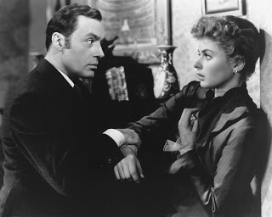
Film Noir
Twenty years after the murder of Alice Barlow, her house is finally occupied again. However, the husband of the couple who have moved in has a secret which he will do anything to keep hidden.

Slide 11
According to Schrader, the first element was World War II and post-war disillusionment. Many of the films during the 1930s and early 1940s were propaganda-type films that were designed to cheer people's bleak outlook during the hard times of the Depression and World War II. It was beginning in the early 1940s, that film noir, such as The Maltese Falcon and Laura, began to appear. The films of the 1940s reflected the disillusionment felt in the country, especially with the soldiers returning home and women losing their jobs at the end of the war. These films, such as The Blue Dahlia, where a sailor comes home to find his wife kissing another man and their son dead due to her drunkenness, showed the cynicism felt by some Americans.
The second element was post-war realism. According to Schrader, post-war Americans wanted an authenticity that was lacking in earlier high-class melodramas. Americans wanted a harsh view of society from the perspective of everyday people on the streets. In addition, ordinary Americans were not as interested in seeing the studio built streets they had been watching since the 1930s. They wanted to be watching actors in actual locations, such as Norma Desmond's mansion (which unfortunately was demolished in 1957 for the headquarters of the Getty Foundation) and Joe Gillis' apartment in Sunset Boulevard.
The third element was the German influence. During the 1930s, especially after the rise of Nazism, many German and Eastern Europeans immigrated to the United States and helped influence the American film industry. Their main influence in film noir is with aesthetics. They brought along expressionist lighting, which used artificial studio lighting to create shadows, oblique and vertical lines, and irregular light patterns.^{ii}
Finally, Schrader says that the fourth element was the hard-boiled tradition. Writers such as Dashiell Hammett, Raymond Chandler, and James M. Cain wrote many books that were eventually turned into film noir. What these authors and films have in common is a cynical and bleak outlook with a tough main character. One of the best examples of a noir film coming from the hard-boiled tradition is Double Indemnity, the script was written by Raymond Chandler from James M. Cain's book of the same name

