Slide 1
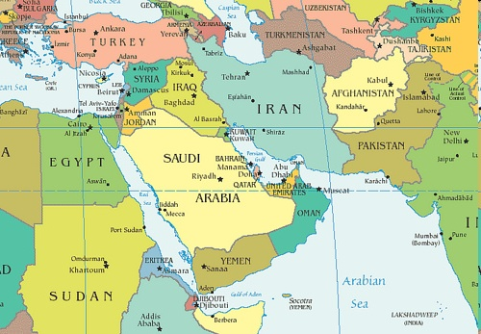
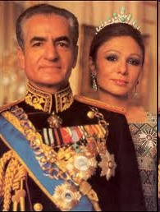
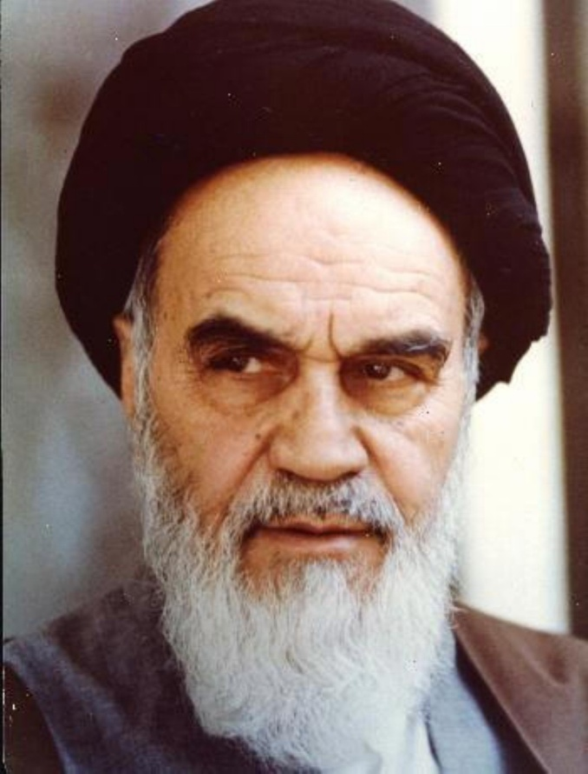
Iran Hostage Crisis
1979
Ayatollah Khomeini
V
Shah Pahlavi

Slide 2
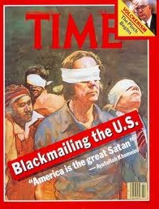
Iran Hostage Crisis ** (1979)
Incident
Nov. 4, 1979 = armed Iranian students take over U.S. Embassy
Held 52 U.S. diplomats hostage.
Held hostage for 444 days! It isn’t until Ronald Reagan becomes president that the hostages are released.

Slide 3
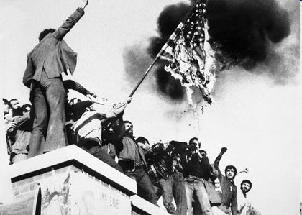

Slide 4
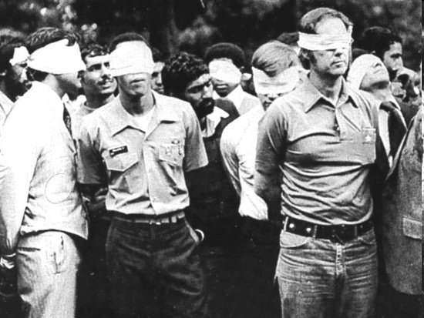

Slide 5
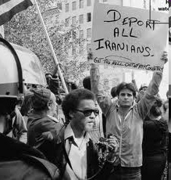
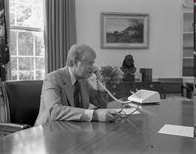

Slide 6
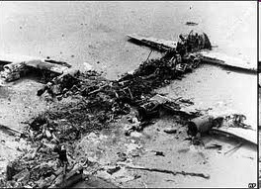
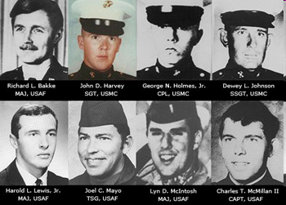
Failed Rescue
Attempt

Slide 7
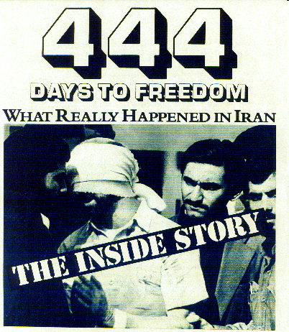

Slide 8
ARGO
Based on real events during the 1979 Iran Hostage Crisis
The film stars Ben Affleck as Tony Mendez, a CIA operative who leads the rescue of six U.S. diplomats from Tehran, Iran
Details of the mission not made public until 1997

Slide 9
Iran Hostage Crisis (1979)
Background Story:
Iranian people were upset with current leader = Shah Pahlavi
Ayatollah Ruhollah Khomeini = Muslim leader. Organized revolution against Iran’s government and Shah Pahlavi
Ayatollah = everyone should live by the word of the Qur’an (sacred book of Islam)
Issue: Ayatollah wants Shah Pahlavi to be executed…however, Pahlavi is in the U.S. being treated for cancer. This angers Ayatollah

