Slide 1
Do Now: Define Racism
Objectives: Students will be able to...
analyze text for key information
(2) describe the importance of Malcolm X
Homework: Finish Project (test Tuesday)

Slide 2
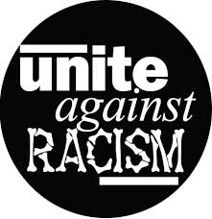
Racism in the US
Prejudice and discrimination plagued South
Refusal to rent to AA
Whites moved out when AA moved in
Channeled into low-paying jobs
Median income 55% of White Median

Slide 3
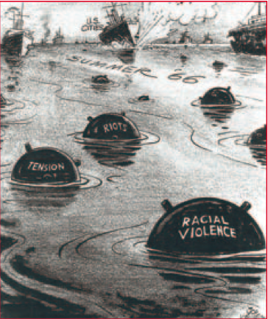
Watts Riot (Los Angeles)
Allegations of police brutality
Lasted 6 days – 14,000 Nat. Guard members needed & 1,500 law officers
Destroyed Neighborhoods
$45 Million in damages
34 Dead
Continued in thousands of cities
Detroit – 43 Dead, 1,000 injured ($250 Million in damages)

Slide 4
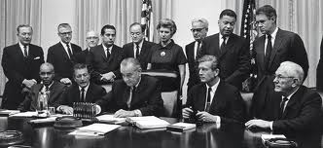
Kerner Commission
Started by LBJ – Investigate causes of riots
Found it was white society and racism
Recommendation:
Create 2 Million more jobs for inner city
6 Million new units of public housing
Renewed fight against de facto segregation
Recommendations never fully endorsed

Slide 5
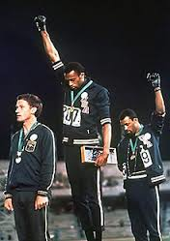
Black Power
MLK failed in Chicago Movement
Many began to turn away from MLK
New Strategies: Armed Self-Defense
Black Power – Many different meanings
Physical self-defense and even violence in defense of one’s freedom
African Americans should control movement (Not Whites)
Stressed racial distinction rather than Cultural Assimilation (Minorities blending into society)

Slide 6
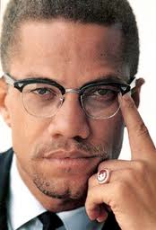
Malcolm (Little) X
Symbol of Black Power
Sent to prison in 1946 – Changed life
Joined Nation of Islam, aka black Muslims (Not same beliefs as mainstream Muslims)
Stressed black nationalism
Ran much of their own society
Advocated self-defense

Slide 7
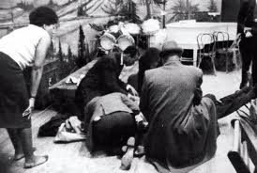
Malcolm X Killed
Went to Makkah (Mecca) and saw many races working together – Gave him positive insight
Broke ties with Nation of Islam & Criticized
Shot and killed by 3 members in 1965
Impact: Influenced African Americans to take pride in culture and believe in ability to make way in the world

Slide 8
Black Panthers
Group formed out of Malcolm X’s beliefs
Believed revolution was necessary in the US
“Ten-point program” developed

Slide 9
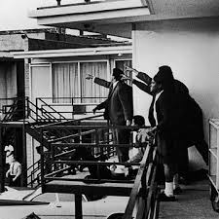
MLK Assassinated
Movement is fragmented
MLK goes to Memphis to support a strike
April 4, 1968 he’s assassinated on hotel balcony
Impact:
Death marked end of an era
Movement continued, but lacked unity and vision

