Slide 1
North V South

Slide 2
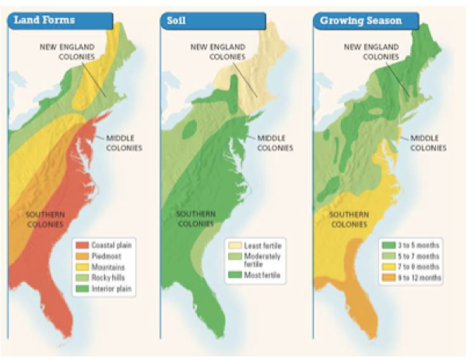
Climate and Geography
• Warm, humid summers and cold snowy winter
Short growing season plus cold made farming difficult.
Water – used to power factories, cities built up around it
• Warm and sunny with long summers, mild winters. Lots of rain.
Climate ideal for agriculture.
Fertile soil ideal for growing crops.

Slide 3
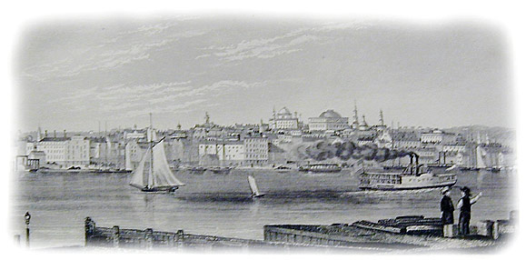
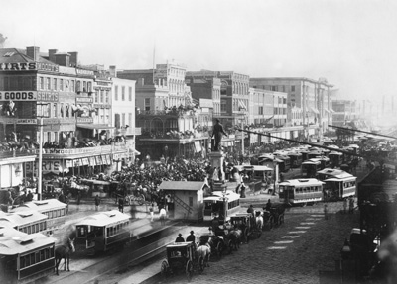
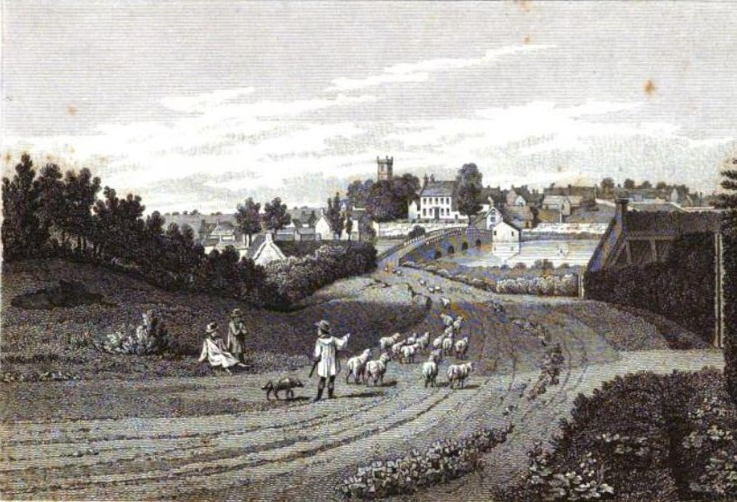
Economy
• The economy of the North was based on manufacturing.
• Many immigrants from Europe began working in factories and producing goods used by people in the North.
• Many factories began producing textiles (cloth) with the cotton grown in the South.
• The economy of the South was based on agriculture.
• Cotton became the most important crop after Ely Whitney’s invention of the cotton gin.
• More slaves were now needed to pick the cotton.
• Slavery became essential to the South’s economy.

Slide 4
Politics
Dem-Rep (National Rep)
More Federalist ideals (loose constitution, strong federal, protect manufacturing)
Against expansion of slavery
Dem-Rep (Democrats)
Truer to Jefferson’s Dem-Rep ideals (strict constitution, protect agriculture)
Want to slavery expand

Slide 5
Society
Urban – culture revolves around the city
Free labor
Wealthiest Region
Rural – cultures revolves around planter elite
Slave labor

Slide 6
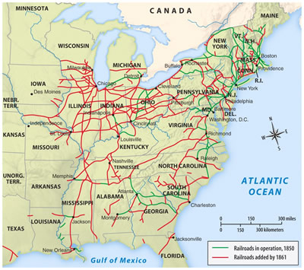
Technology
Transportation – More canals and RR allow business to grow
Industrialization – interchangeable parts, automatic looms, steam power allows the factory system to grow
Inventions – cotton gin allows textile factories to grow
Transportation – depended on steam ship, less RR
Industry – very little, focus on agriculture, dependent on North & Europe for goods
Inventions – cotton gin leads to cotton boom and increase demand for slavery
Mechanical reaper and steel plow help advance agriculture

Slide 7
Southern Society
Large Planters – social and political control, owned 50 or more slaves
Planters – 20-49 slaves (lawyers, bankers, etc)
Small Slaveholders – fewer then 20 slaves, primarily farmers
Non slaveholder – yeoman, own small pieces of land or squatted, grew enough to feed family
Free Blacks – Usually found in upper South, limited mobility and economic advancement. Usually tenant farmers or day laborers
Slaves – almost all born in America, 75% worked on plantations/medium farms. 10% hard labor not fit for whites

Slide 8
Northern Society
Upper class - Factory owners, merchants, bankers, large farmers
Middle Class – begins to emerge in early 1800’s. Farmers (still number one occupation in America) artisans, lawyers, shopkeepers, ministers , managers at factories/mills (white collar)
Lower Class - blue collar jobs; industrial workers (skilled and unskilled) small farmers, free blacks, unemployed

