Slide 1
Today’s Topic: The Beginnings of Pop Culture
Turn of the “Modern Century”
1900s
1.) When & How did we become a nation consumed by Popular Culture?
2.) Who is the Father of Pop Culture?

Slide 2
In order to create Popular Culture…. People need:
More Money!
TO SPEND CONSUMING
POP CULTURE
More Free-Time!
TO PARTICIPATE IN POP CULTURE

Slide 3
In order for something to be popular, lots of people have to know about it.
At the Turn of the 20th Century (1900s):
Q: What are some things preventing people from taking part in pop culture?
Long work hours = don’t have time for it
Low pay = can’t afford to be part of it
Uneducated = can’t read about it, can’t learn about it
Lack of movement = hard to spread ideas

Slide 4
Henry Ford’s Assembly Line!
Mass Production

Slide 5
Long work hours = don’t have time for it
Low pay = can’t afford to be part of it
Uneducated = can’t read about
it, learn about it
Lack of movement = hard to spread ideas
8 hour work day = more leisure time
Paid $5/day; provided housing
Better Pay = kids don’t work and go to school
Hello, he invented
the car

Slide 8
The “Sunday Drive”

Slide 9
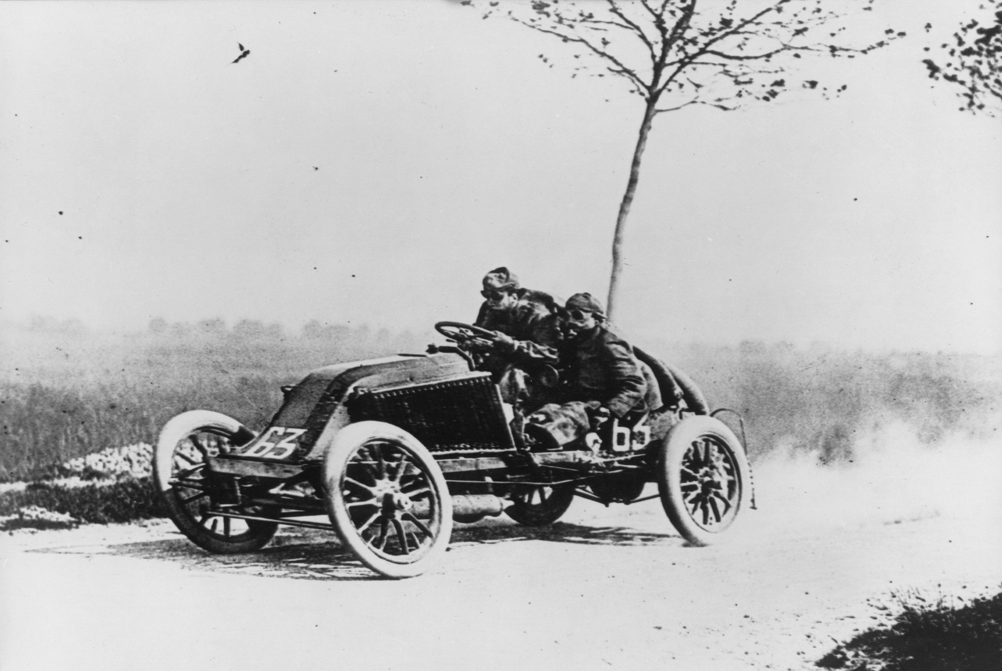
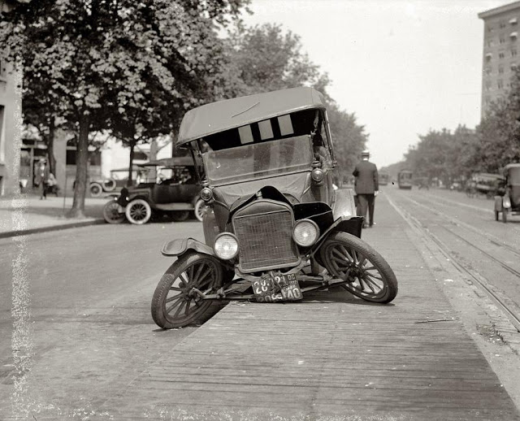
96 people died in 1900 from car accidents

Slide 10
Cars influenced fashion:

Slide 11
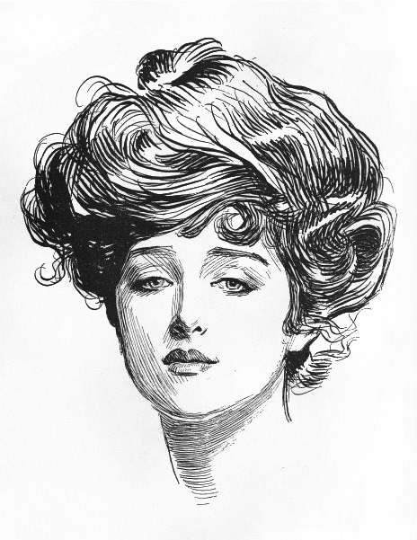
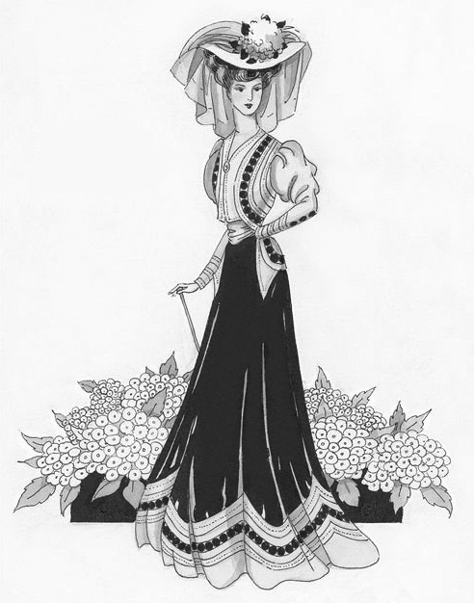
Pre-1900s ideal woman: “Gibson Girl” (personification of the feminine ideal of beauty)
Before Cars

Slide 12
Hobble Skirt
Before Cars
After Cars

Slide 14
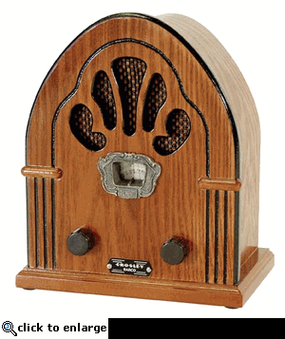
How was social life in the 1920s different from that of the late 19th century?
THE RADIO!
Why is radio
super important
to the development
of American
pop culture?
Not only reaches a larger audience,
but also
Everyone can listen,
even the poor who couldn’t
read could still enjoy radio.
EX. Amos & Andy

Slide 15
How was social life in the 1920s different from that of the late 19th century?
People had NEW interests: Art, Music & Film
Modern Art focused on illustrating modern social problems.

Slide 16
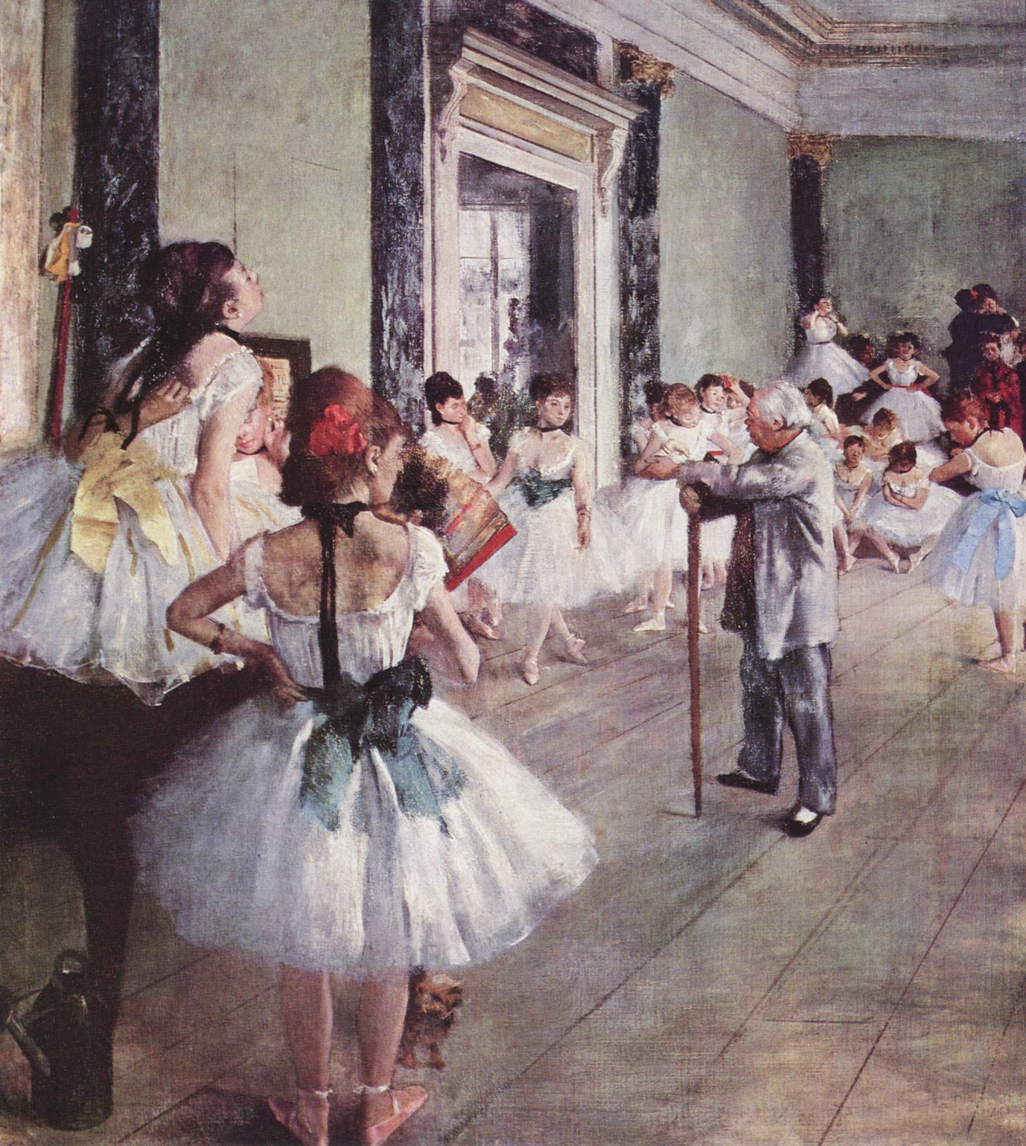
1900s Realism
is all about
painting things
the way they actually
look

Slide 17
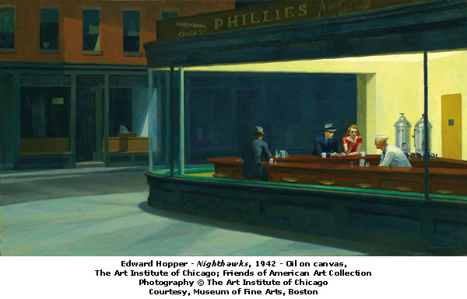
Edward Hopper’s Nighthawks
Modern Art

Slide 18
How was social life in the 1920s different from that of the late 19th century?
People had NEW interests: Art, Music & Film
Modern Art focused on illustrating modern social problems.
Music = Jazz – influenced by African American culture
Louis Armstrong, Billie Holiday

Slide 19
The Hays Code
The rules:
“No picture shall be produced that will lower the moral standards of those who see it”
Only correct standards of life shall be presented
No ridicule of the law or law enforcement agencies (criminals cannot be shown in a sympathetic light)
NO: nudity, “suggestive” dancing, ridicule of religion, no drug use, methods of crime, homosexuality, interracial marriage, STDs, or depiction of child birth, scenes of passion, excessive and lustful kissing

Slide 20
How was social life in the 1920s different from that of the late 19th century?
People had NEW interests: Art, Music & Film
Modern Art focused on illustrating modern social problems.
Music = Jazz – influenced by African American culture
Film: silent, but now we had a model for behavior.
Sheik, Jazz singer, Steamboat

Slide 21
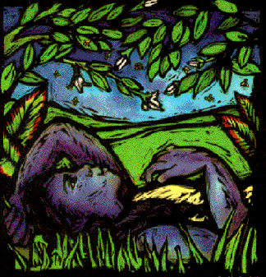
The Harlem Renaissance
Term given to the explosion of African American Culture coming from Harlem NY in the 1920s

Slide 22
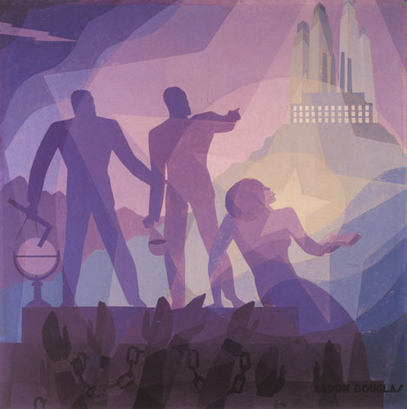
Why did African Americans migrate to Northern Cities during and after WWI?
WWI → Great Migration …Blacks moved north in search of jobs and freedom.
City = Industry = JOBS!

Slide 23
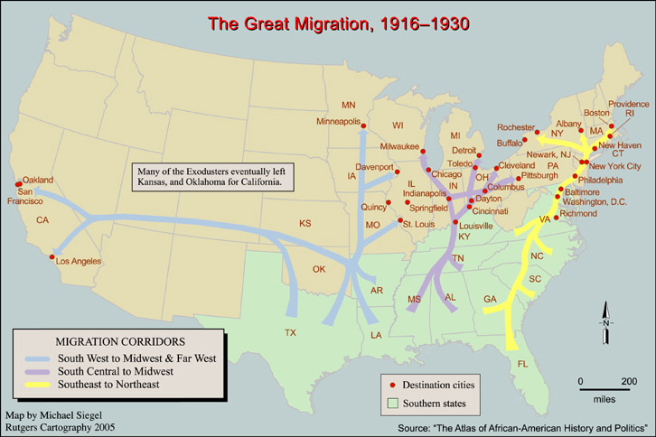

Slide 24
How did the Harlem Renaissance influence American Life?
-Af. Am leaders like W.E.B DuBois (leader of the NAACP), thought that contributing to culture could be a step towards equality.
-Used Art/Music as propaganda to advertise how beneficial blacks were to American life

Slide 25
How did the Harlem Renaissance influence American Life?
Langston Hughes:The Negro Speaks of Rivers
I’ve known rivers:
I’ve known rivers ancient as the world and older than the
flow of human blood in human veins.
My soul has grown deep like the rivers.
I bathed in the Euphrates when dawns were young.
I built my hut near the Congo and it lulled me to sleep.
I looked upon the Nile and raised the pyramids above it.
I heard the singing of the Mississippi when Abe Lincoln
went down to New Orleans, and I’ve seen its muddy
bosom turn all golden in the sunset.
I’ve known rivers:
Ancient, dusky rivers.
My soul has grown deep like the rivers.
Message?

Slide 26
How did the Harlem Renaissance influence American Life?
Langston Hughes:
What happens to a dream deferred?
Does it dry up
like a raisin in the sun?
Or fester like a sore—
And then run?
Does it stink like rotten meat?
Or crust and sugar over—
like a syrupy sweet?
Maybe it just sags
like a heavy load.
Or does it explode?
Message?

Slide 27
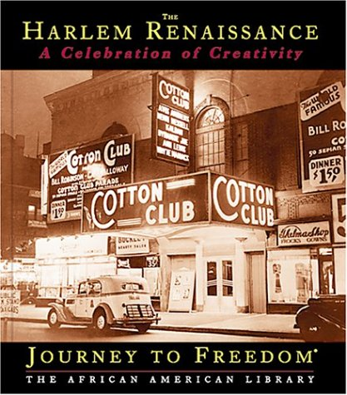
Not a Quiz
How did the Harlem Renaissance influence American Life?
Cotton Club:
Blacks could
Entertain but…
“Jim Crow Laws”
Could not be
customers
1920s: Were Blacks and other minorities truly becoming more equal?

Slide 28
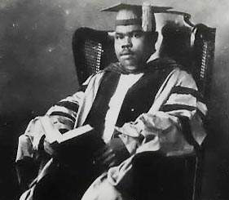
How did the Harlem Renaissance influence American Life?
Harlem’s Decline:
A.) Black Nationalism
Marcus Garvey
Said: blacks are not equal, therefore they should move back to Africa.
B.)The Great Depression
Marcus Garvey

