Slide 1
Today’s Topic: The Beginnings of Pop Culture
Turn of the “Modern Century”
1900s
1.) When & How did we become a nation consumed by Popular Culture?
2.) Who is the Father of Pop Culture?

Slide 2
In order to create Popular Culture…. People need:
More Money!
TO SPEND CONSUMING
POP CULTURE
More Free-Time!
TO PARTICIPATE IN POP CULTURE

Slide 3
Late 1800s America:

Slide 4
In order for something to be popular, lots of people have to know about it.
At the Turn of the 20th Century (1900s):
Q: What are some things preventing people from taking part in pop culture?
Long work hours = don’t have time for it
Low pay = can’t afford to be part of it
Uneducated = can’t read about it, can’t learn about it
Lack of movement = hard to spread ideas

Slide 5
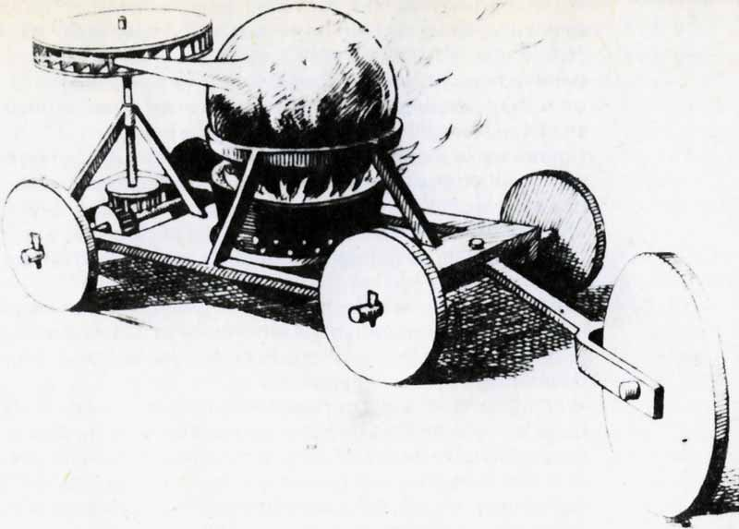
True or False: Henry Ford invented the car.
False!
1672 = Ferdinand Verbiest created the first steam
powered “vehicle”
  Designed a steam propelled trolley as a toy for the emperor

Slide 6
1769 = Nicolas Cugnot designed the world’s
first working self-propelled vehicle
  Weighed 2.5 tons
  2 rear tires, 1 front
  Seated 4 passengers
  Speed: 2 mph

Slide 7
David Dunbar Buick
Ransom E. Olds
Walter Chrysler
Karl Benz

Slide 8
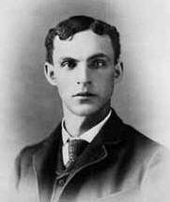
Henry Ford: The Father of Pop Culture
July 30, 1863 -- April 7, 1947
Did not invent automobile, but developed the first automobile that Americans could afford
Helped to develop the assembly line technique of mass production
In 1914, sales passed 250,000. By 1916, sales reached 472,000.
By 1918, half of all cars in America were Model T's.

Slide 9
Henry Ford’s Assembly Line!
Mass Production

Slide 10
Long work hours = don’t have time for it
Low pay = can’t afford to be part of it
Uneducated = can’t read about
it, learn about it
Lack of movement = hard to spread ideas
8 hour work day = more leisure time
Paid $5/day; provided housing
Better Pay = kids don’t work and go to school
Hello, he invented
the car

Slide 12
Detroit = Motor City

Slide 15
The “Sunday Drive”

Slide 18
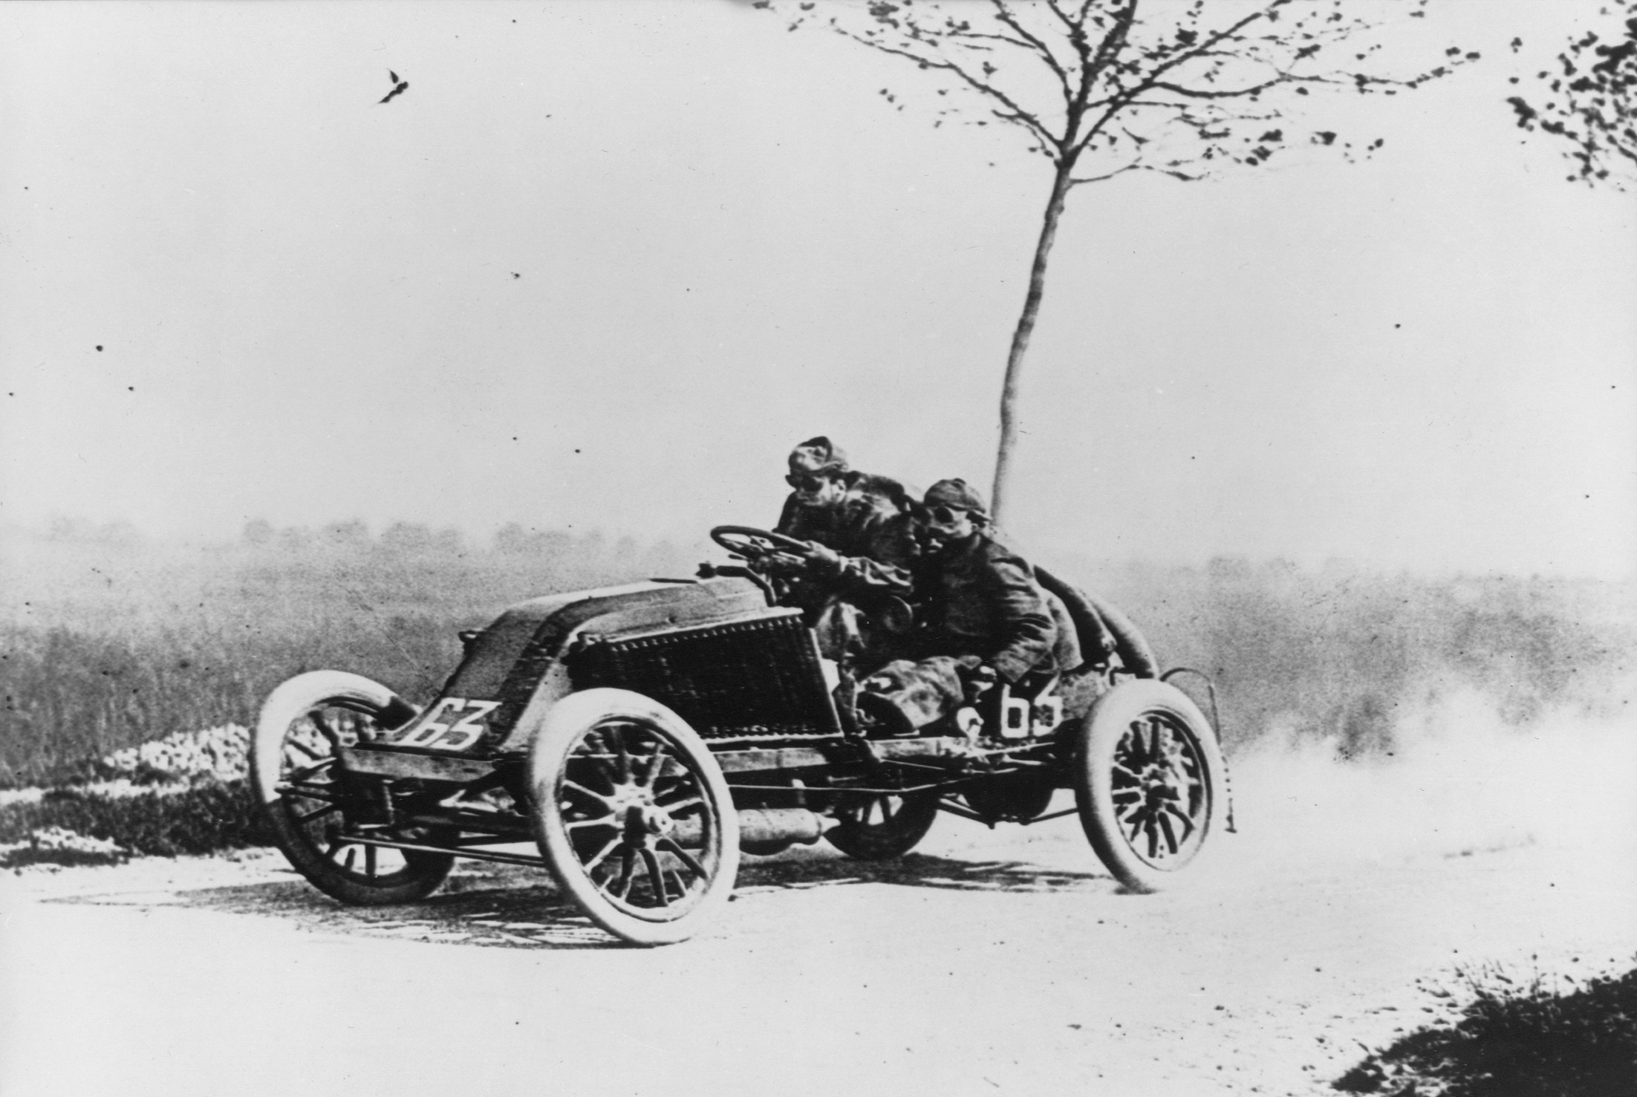
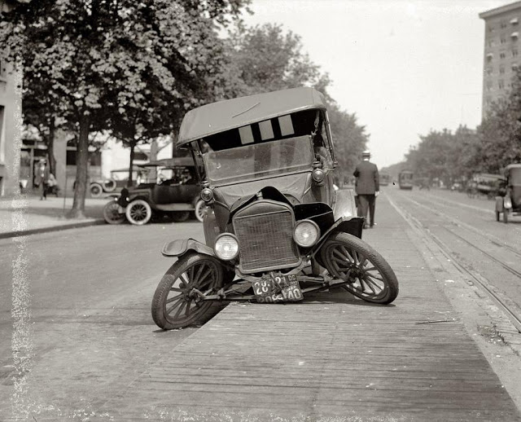
96 people died in 1900 from car accidents

Slide 19
Cars influenced fashion:

Slide 20
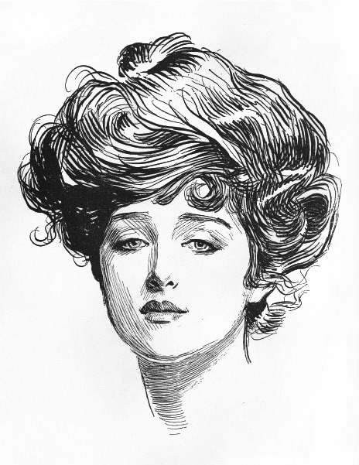
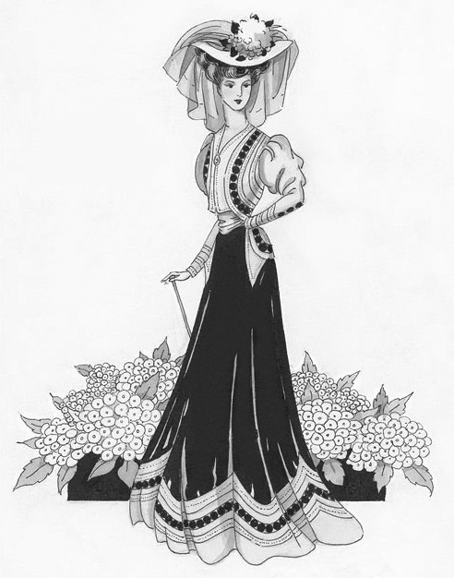
Pre-1900s ideal woman: “Gibson Girl” (personification of the feminine ideal of beauty)
Before Cars

Slide 21
Hobble Skirt
Before Cars
After Cars

