Slide 2
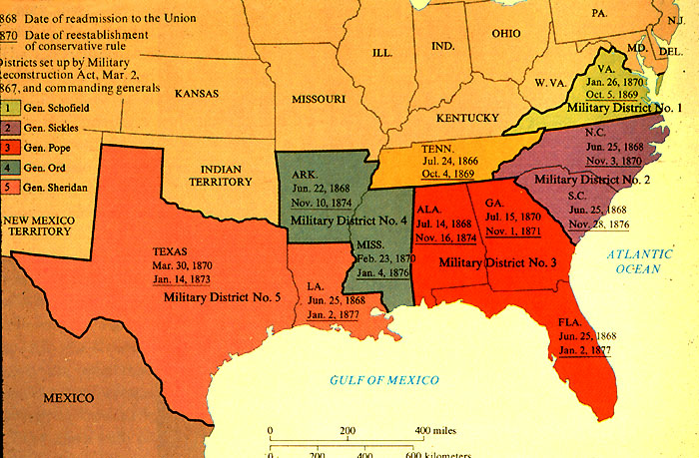
Tennessee passes 14th Amendment

Slide 3
People
Andrew Johnson = First president to be impeached
Ulysses S Grant =President during the Whiskey Ring & Panic of 1873
Rutherford B Hayes = Ended Reconstruction
Samuel Tilden = Won the popular vote in 1876, but lost Presidency
Abe Lincoln = Assassinated five days after Civil War

Slide 4
Amendments
14th = Granted Citizenship
13th = Ended Slavery
15th = Right to vote can not be denied because of race . .

Slide 5
Reconstruction Plans
 | Lincoln | Wade-Davis | Johnson | Military
Treatment of Confederates | Amnesty and take oath | Confederate officials cannot hold office | Pardons, states reject debt | Creates military zones, confederates cannot vote
Treatment of Blacks | Only soldiers and educated blacks can vote, not citizens | States had to outlaw slavery | Didn’t stop black codes | Passed 14th and 15th amendment

Slide 6
Impeachment
AJ tries to fire Edwin Stanton (Secretary of War) which went against Tenure of Office Act = said that he couldn’t fire anyone without Congresses approval. AJ is impeached but not found guilty because many were afraid it would set dangerous precedent and leave country to vulnerable after the war

Slide 7
Election 1876
Samuel Tilden receives more popular votes then Rutherford B Hayes but neither has enough electoral votes.
Compromise of 1877 uses a committee of 15 to pick winner. Hayes is chosen after he reportedly promises to remove troops to end Reconstruction
April 1877 Hayes removes troops, Reconstruction is over!

Slide 8
Reconstruction
Successes
Restored the Union
S economy grew, new wealth created
14th & 15th Amendment
Freedmen's bureau
S. states adopt mandatory education
Failures
White south bitter
S. is slow to gain industry
After troops leave terrorist groups deny AA rights
Many AA & whites trapped in poverty
Racist attitudes continue

Slide 9
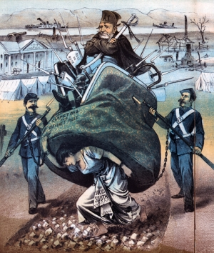
Women carrying bag, two soldiers, etc
Reconstruction
Women = south, soldiers = military reconstruction, old dude = Grant
Reconstruction is hurting the South, not a good thing

Slide 10
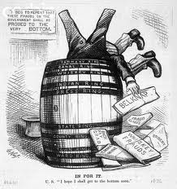
Guy stuck in barrel, papers everywhere
Grant’s Scandals = Whiskey ring
US Grant
Corruption of the Republican government

