Slide 1
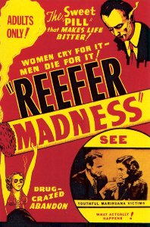
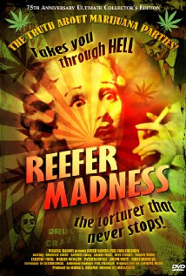
Reefer Madness

Slide 2
Hays Code/ Hollywood Production Code
Cannot say:
*&^$^@
Or
$%#@^*
Or
$#@*()&^
Or
#%%#&@@
OR
#@&*^%#
Why it was needed:
The rules:
“No picture shall be produced that will lower the moral standards of those who see it”
Only correct standards of life shall be presented
No ridicule of the law or law enforcement agencies (criminals cannot be shown in a sympathetic light)
NO: nudity, “suggestive” dancing, ridicule of religion, no drug use, methods of crime, homosexuality, interracial marriage, STDs, or depiction of child birth, scenes of passion, excessive and lustful kissing,

Slide 3
Exploitation Film
Films that are both low budget and of low moral/artistic merit
Also known as “B movies”
Trying to make money based on “exploiting” (taking advantage of) a current trend OR shocking subject matter
Films need something to exploit, like a big star, special effects, sex, violence, or romance
Dramatize facts to influence audiences

Slide 4
1936 – Reefer Madness
Originally financed by a church group – Called “Tell Your Children”
intended to be shown to parents as a morality tale attempting to teach them about the dangers of cannabis use
Bought by famous Exploitation film maker and mass marketed as “Reefer Madness”
education-exploitation films common after stricter version of Hay’s Code adopted in 1934
1930-1937 = marijuana was a hot topic b/c Harry Anslinger (Fed Bureau of Narcotics) started a campaign against marijuana use.

Slide 5
Anslinger’s Campaign
Radio Address:
“An entire family was murdered by a youthful addict in Florida. When officers arrived at the home, they found the youth staggering about in a human slaughterhouse. With an axe he had killed his father, mother, two brothers, and a sister. He seemed to be in a daze…had no recollection of having committed multiple crimes. The officers knew him ordinarily as a sane, rather quiet young man; now he was a pitifully crazed. They sought the reason. The boy said that he had been in the habit of smoking something which youthful friends called “muggles” a childish name for marijuana.”

Slide 6
Other 1930s Exploitation Films
Damaged Lives (1933)
A boss insists that a young executive go with him to a party and while there he sleeps with a wealthy young woman, contracting syphilis from her, leading his girlfriend to commit suicide
Tomorrow’s Children (1934)
A young woman wishes to marry and raise a family but has been deemed “defective” by state health authorities so a court orders her to undergo sterilization to prevent “defective genes” from being passed on to any more children

