Slide 1
Real Postwar Danger:
Teenagers!
1) How do teenagers act in the 1950s?
2) Why are parents afraid of Rock n Roll music??

Slide 2


Slide 3
Beatniks & Rock n Roll
The 1950s Rebels

Slide 4
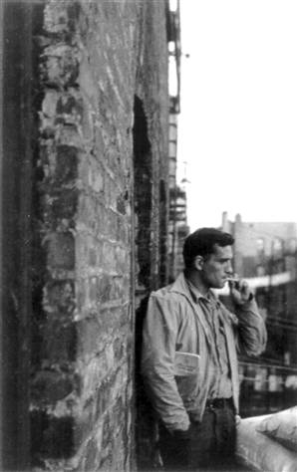
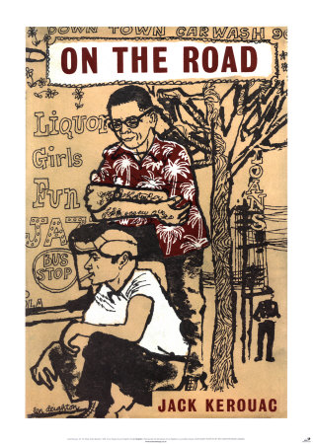
The Beatniks
Mostly white artist who felt “beat down” by American culture.
Looked for alternative lifestyles (rejected suburbia)
They are the rebels, the non-conformists
  Ex: Jack Kerouac who wrote “On The Road”

Slide 5
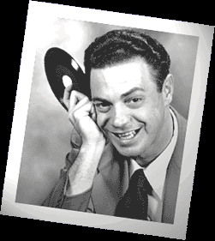
Rock n Roll
Rock ‘n’ roll = music with a loud and heavy beat.
1st played by Alan Freed, Cleveland, Ohio
Influenced by African American rhythm and blues.
SCARED parents! = Generation gap

Slide 6
Rock 'n' Roll Music
Fear = African American music will influence white teens!!!

Slide 7
Parents were afraid rock n roll
would cause children to
misbehave…
…So they tried to ban it

Slide 8
1950s FEAR = Teenagers
juvenile delinquency = antisocial or criminal behavior of young people
The book 1,000,000 Delinquents predicted that by 1955 1 million teens would have criminal records.

Slide 9

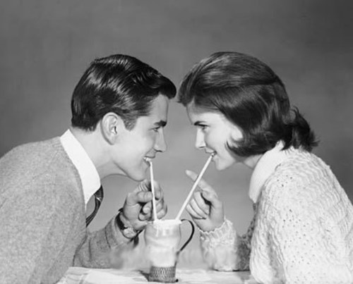
Doo-Wop For Lovers
Will You Be Mine
In the Still of the Night
Stand By Me

Slide 10
Women of Rock n Roll
My Boyfriend’s Back – The Angels
I Will Follow Him – Peggy March
Soldier Boy – The Shirelles
You Don’t Own Me – Lesley Gore

Slide 11
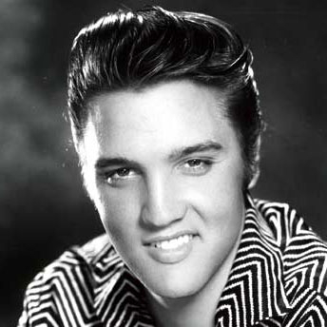
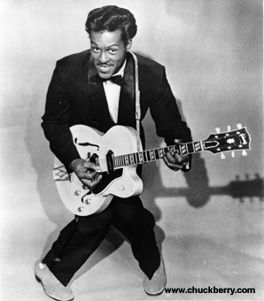
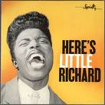
Rock 'n' Roll ICONs
Little Richard
Elvis
Chuck Berry

Slide 12
Rock 'n' Roll Music Made
Teens Out of Control!
New Dance Moves
The Stroll
The Fly
The Twist
The Hand Jive

