Slide 1
Theodore Roosevelt Presidency

Slide 2
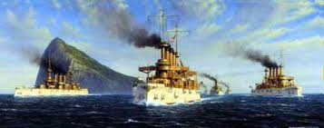
Foreign Policy
Open Door Policy- all nations should be allowed to trade with China
Use Great White Fleet for intimidation
Roosevelt Corollary- “Speak softly and carry a big stick”
US right to protect economic interest in Western Hemisphere by force (Monroe Doctrine)
Use it in Panama

Slide 3
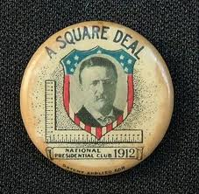
Domestic
Square Deal - President Theodore Roosevelt's domestic program formed upon three basic ideas: conservation of natural resources, control of corporations, and consumer protection
Aimed at helping middle class citizens and involved attacking bad trusts while at the same time protecting business from the most extreme demands of organized labor.
Roosevelt was a liberal Republican who believed in government action to mitigate social evils

Slide 4
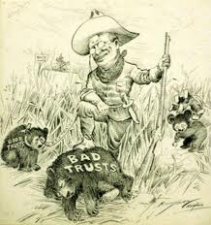

Slide 5
Domestic - Business
Trust Busting – Large Businesses
Trust were created to improve the organization of large businesses, but used abusive practices and often used their size to exclude competition
Sherman Anti-Trust Act (1890) makes Trust illegal
Five major RR companies merge and form Northern Securities, sued and dissolved under SAT
TR earns the name Trust Buster, but he does believe most Trust are useful as long as the don’t abuse power

Slide 6
Domestic - Business
Bureau Corporation – created to investigate businesses and then publish results
TR enters into “gentlemen agreements” with many companies. Allow companies to be investigated in exchange they get time to fix issues before legal action can be taken
TR can regulate business without ending benefits of many trusts

Slide 7
Domestic – Business
Hepburn Act – Strengthens Interstate Commerce Commission
Sets maximum RR rates, ends free rides to loyal customers, government gets access to books
Benefitted the RR by limiting competition and government set rates ensure profit

Slide 8
Domestic – Business
Unions – 1902 Coal Miner Strike; cost of coal and unemployment increasing
Roosevelt wants both sides to enter arbitration, United Mine Workers agree but Owners want to crush union and refuses
TR threatens to send in army to take over mines, Owners accept arbitration
Result: Coal miners receive 10% raise and 9 hr day, membership in Unions increase.
1st time government broker peace between the owners and workers, sign of changing view of unions

Slide 9
Domestic - Consumer
TR passes legislation to improve conditions exposed by muckrakers
Meat Inspection Act –Upton Sinclair The Jungle and reports show chemicals added to meats dangerous
Federal inspection of all meat sold through interstate trade and set standards of cleanliness

Slide 10
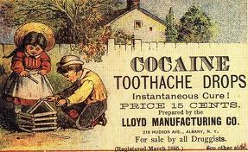
Domestic – Consumer
Pure Food and Drug Act - many products were making claims that they cured a variety of ills but in reality contained dangerous additives (opium, cocaine, caffeine, alcohol)
prohibited sale & manufacturing of impure or falsely labeled items

Slide 11
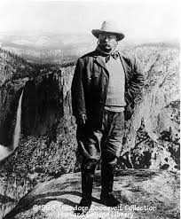
Domestic - Environment
Conservation – resources were being used at an alarming rate
Prior policy sold federal land to lumber companies hoping they would preserve land during TR time create regulations controlling how much timber could be cut on federal land
TR helps to create 5 national parks and 51 wildlife reservations

Slide 12
Legacy
TR increase the power of the executive office
For the first time the American people will begin to look to the federal government to solve social and economic issues

