Slide 1
WWI: New Weapons

Slide 2
Trenches describe what a trench looks like

Slide 3
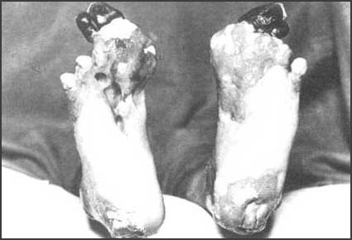
Trench Foot

Slide 4
Battle Gear What did Troops carry with them?

Slide 5
Tanks How many soldiers did a tank hold?

Slide 6
Airplanes What did a WWI airplane look like?

Slide 7
Machine guns Why were machine guns not really used for offensive moves?

Slide 8
Poison Gas Used to break stalemates

Slide 9
Impact
New weapons = changed war forever
War = way more destructive and bloody
Looking ahead = WWII A Bombs

