Slide 1
William Howard Taft

Slide 2
Foreign Policy – Dollar Diplomacy
Promoted giving money to Latin America to help stabilize these countries
strengthen security for the Panama Canal, increase American trade, and diminish the presence of European nations in the area

Slide 3
Domestic – Payne Aldrich
Campaign promise to lower tariffs (believed high tariffs hurt consumers), TR told him to avoid the issue
End result – Progressives believe tariff rate set to high and while others don’t think it was raised enough.

Slide 4
Ballinger-Pinchot
Pinchot hired by TR to run Forest Services, accuses his boss Secretary of the Interior Ballinger of selling public land
Taft fires Pinchot for leaking story
Controversy further alienates Taft from the Progressives

Slide 5
Trust Busting
Goes after more then 90 trust (more then TR)
Taft brings Anti-trust suit against US Steel. TR believed US steel was one of the good trust and will break from Taft and run for president again in 1912

Slide 6
16th Amendment
Proposed by Taft as solution to Tariff debate and a way to generate money
It allows government to tax income

Slide 7
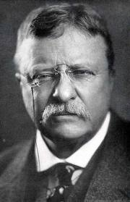
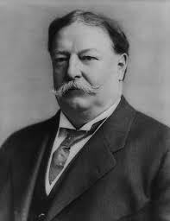
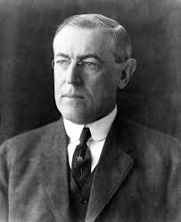
Election of 1912
William Howard Taft Woodrow Wilson Theodore Roosevelt
Republican Democrat Bull Moose Party

Slide 8
Election 1912
Taft had alienated to many groups, election contest between Roosevelt and Wilson
Roosevelt – New Nationalism – more powerful federal government to regulate monopolies, rights for women/kids
Wilson – New Freedoms – called for less government, Tariff/business reform
Roosevelt and Taft split vote allowing Wilson to win electoral college

Slide 9
Taft’s Legacy
Seen as indecisive president that lacked leadership skills
Actually broke up more trust then Roosevelt, passes income tax (16th), political processes becomes more democratic (17th)

